Slide 1
HEMOGLOBIN (Globin chain) VARIANTS
HEMOGLOBINOPATHIES
Dr Sapna Patel
Assistant Professor,
Dept of Biochemistry,
GMC Bhavnagar.

Slide 2
Hemoglobinopathies
Abnormalities :-
1. Sequence of AA in Globin chain- Qualitative
2. Number of Globin chain- Quantitative
Adult Hb (HbA) = 2 α + 2 β chains
Fetal Hb (HbF ) = 2α + 2γ chains
HbA2 = 2α + 2δ chains

Slide 3
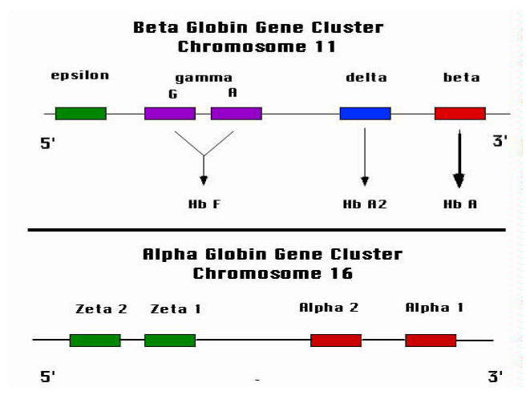

Slide 4
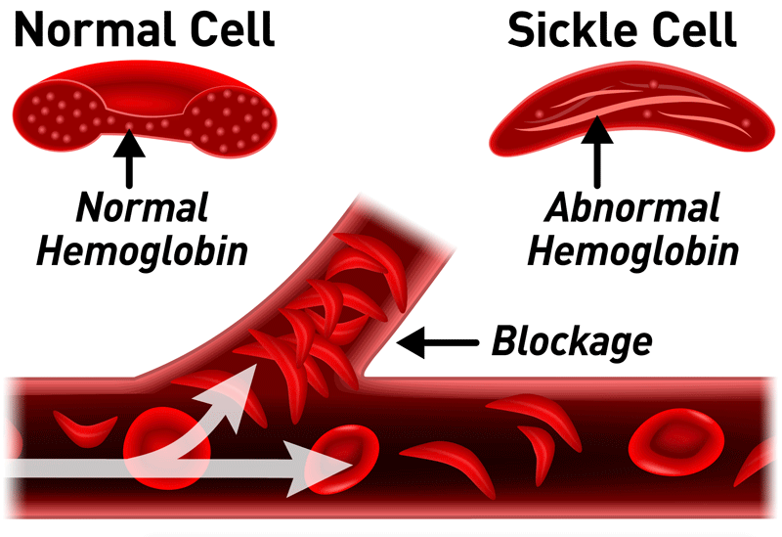

Slide 5
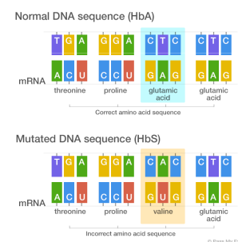

Slide 6
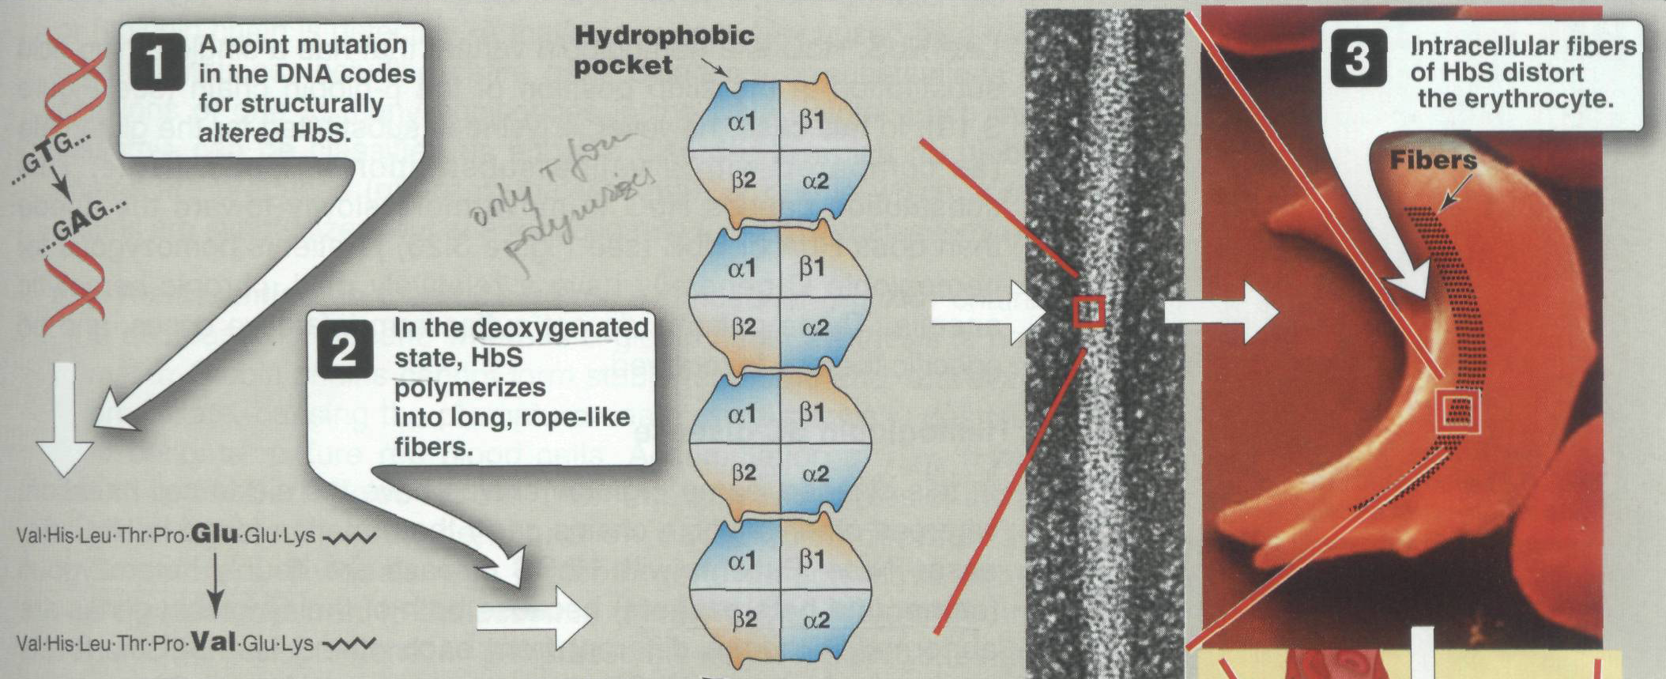

Slide 7
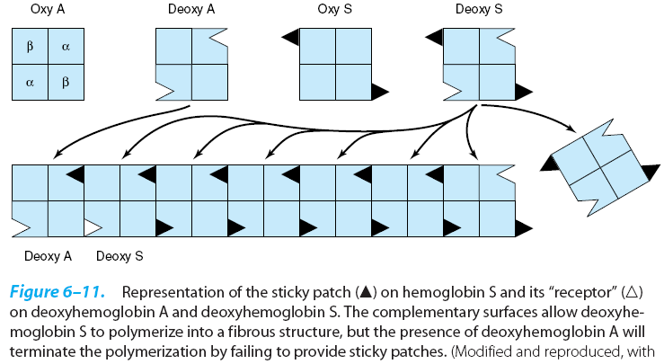

Slide 8
Sickle Cell Disease
Point mutation(Substitution) in the 6th position of beta chain
The glutamic acid of HbA is changed to valine in HbS.
Glutamic acid = Hydrophilic & Negative Charge
valine = Hydrophobic & Neutral Charge
HbS can bind and transport O2.

Slide 9
The deoxygenated HbS -protrusion on one side and a cavity on the other side
Polymerization of hemoglobin
Long insoluble fibers RBCs.
Rigidity of membrane, Distortion of RBS shapes
RBC Stuck in fine capillaries leading
Blockage in organs (spleen, brain, liver, kidneys, bones, joints, fingers, toes etc.)
This leads to hypoxia and is the cause of painful episodes.
Splenic Infarct & Avascular Necrosis of Femur Head

Slide 10
HbA and HbF will prevent sickling, because they do not co-polymerize with HbS.
The sickling occurs under deoxygenated state.

Slide 11
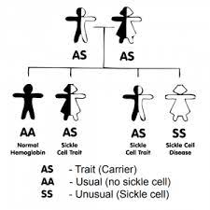
Sickle Cell Trait
Heterozygous state is very common in Central and West Africa, East and Central India.

Slide 12
Sickle Cell Trait
Heterozygotes (AS) - 50% of Hb normal.
Does not produce clinical symptoms.
Hypoxia at higher altitudes
Chronic lung disorders

Slide 13
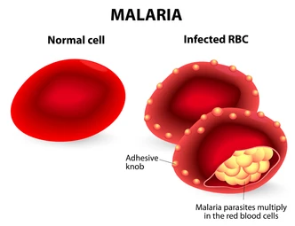
Sickle Cell Trait Protects from Malaria

Slide 14
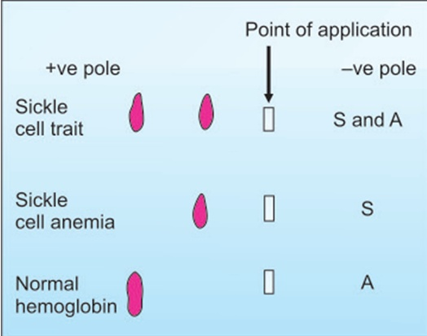
Electrophoresis at pH 8.6
Electrophoresis

Slide 15
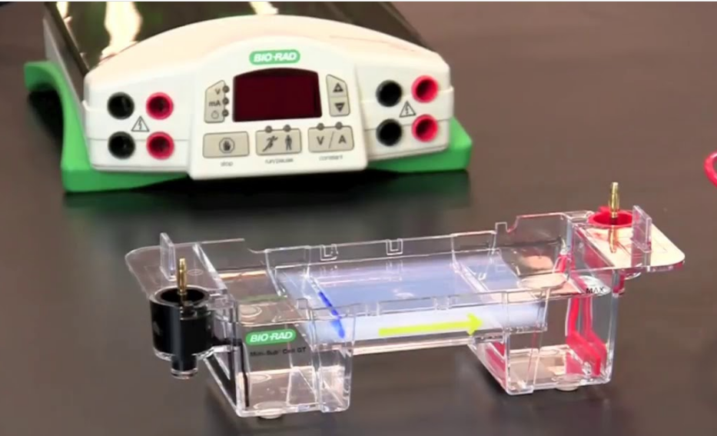
Electrophoresis

Slide 16
Electrophoresis
Lack of Carboxyl group of Glutamic acid in HbS
Lack of Negative charge Glutamic acid.
HbS - less negatively charged
Decreases electrophoretic mobility
HbS move slower than HbA

Slide 17
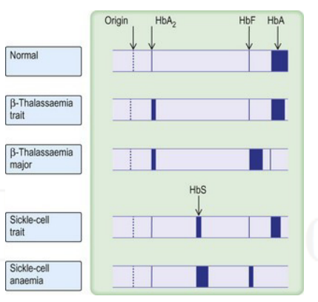

Slide 18
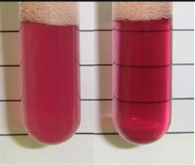
Dithionite test-Sickling Test
Inexpensive & Rapid
Use for Screening
Less Sensitive
The reagent consists
Saponin - Make RBC Haemolysis
Na-dithionite - Make Hb deoxygenates
Principle :
Reagent make Hb deoxygenated and causes polymerazition of HbS and Turbidity of Sample

Slide 19
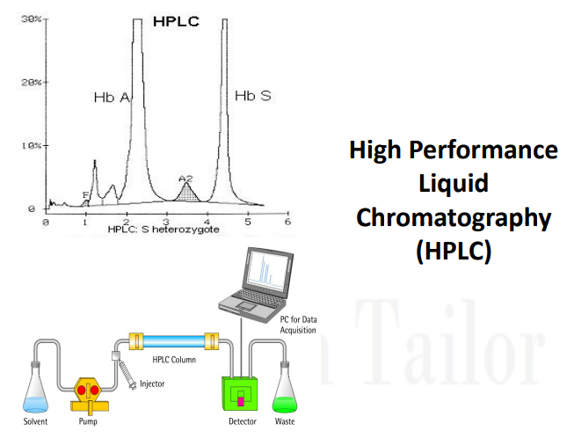

Slide 20
Management
Hydroxyurea
Induce gene for gamma globin chain
5 to 10 % fetal Hb synthesis
Interfere with polymerization of deoxy HbS
Prevent crisis and improve oxygenation
Oxygenation Sickle Cell Disease
Decrease concentration of deoxygenated Hb
Decrease in polymerization & Decrease lysis of RBC
Hydration
Increase in body fluid
Increase in circulation
Increase in oxygenation & Decrease polymerization
Decrease in lysis of RBC

Slide 22
Important Hemoglobinopathies
Hb | Point mutation position | Amino acid substitution | Codon and base substitution
HbS | Beta 6 | Glu→Val | GAG→GUG
HbC | Beta 6 | Glu→Lys | GAG→AAG
HbE | Beta 26 | Glu→Lys | GAG →AAG
HbD-Punjab | Beta 121 | Glu→Gln | GAG →CAG
HbM | Proximal or distal histidine in α or β chains | His→Tyr | CAC →UAC

Slide 23
A 14 years male child comes in an emergency with a complaint of Acute abdominal pain and Acute hip joint pain. Paediatrician asked for ICU admission and for following investigation
Hemoglobin 6.5 gm%
Total Billi 3.4 mg%
Direct Billirubin 0.8 mg%
Indirect Billirubin 2.6 mg%
S. ALP-950 IU/L
S.LDH -2000 IU/L
Peripheral Smear examination-Sickle shape RBC.

Slide 24
Pediatrician diagnosed the case as a Sickle cell crisis and ask to collect the blood sample for Hb electrophoresis for confirmation of diagnosis, before starting the following Treatment
Oxygen inhalation
Inj Normal Saline(Hydration)
Inj Whole Blood
Tab Hydroxyurea

Slide 25
What is molecular abnormality in sickle cell disease?
What is the reason for Acute abdominal and Hip joint pain?
What is the reason for decreased Hemoglobin in this case?
What is the type of jaundice in this case? Justify.
Explain biochemical reasons for High level of ALP and LDH.
What could be a pattern in Hb electrophoresis for differentiation of type of sickle cell anemia?
Why blood sample should be collected before blood transfusion for Hb electrophoresis?
What is a biochemical mechanism of using hydroxyurea in this case?
What is the biochemical significance of oxygen inhalation?
What is the biochemical significance of hydrating the patient?
How does this disease give protection against malaria?
Which is the screening test that can be performed at the Primary health center?
Name the confirmatory test for sickle cell disease.

Slide 26


