Slide 1
SULPHUR CONTAINING AMINO ACIDS METABOLISM
METHIONINE & CYSTEINE

Slide 2
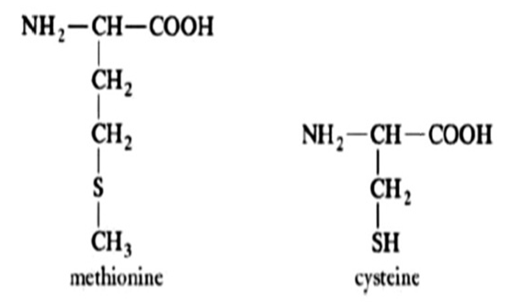
Essential
Thio ether Linkage
Non Polar
Glucogenic
Non Essential
Thio Alcohol Linkage
Polar
Glucogenic

Slide 3
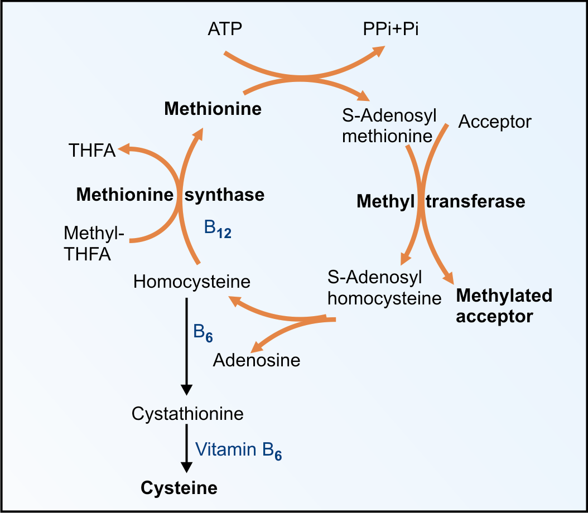
Classical/type 1
Serine
Cystathionine Beta Synthase
Cystathioninuria
Cystathionase
Homoserine

Slide 4
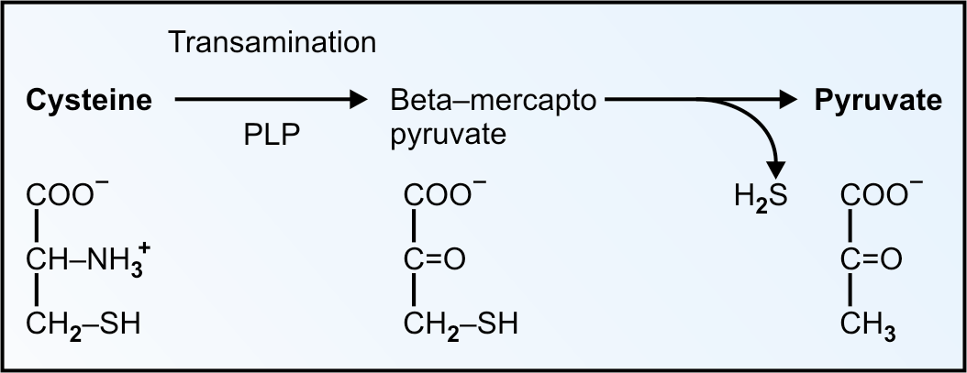

Slide 5
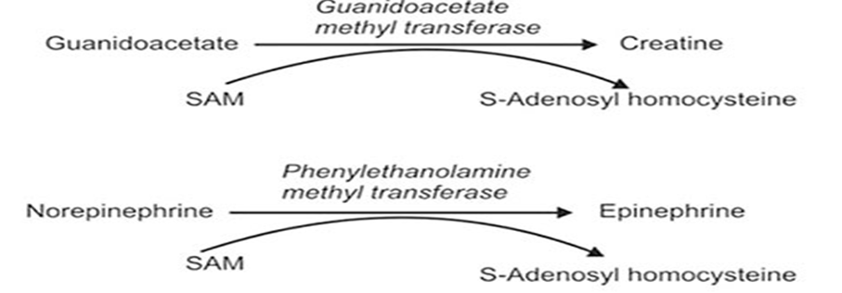
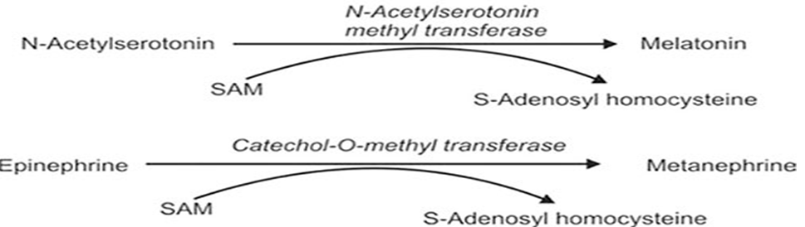

Slide 6
HOMOCYSTINEMIAS
Increase Homocysteine level in blood.
Causes :
Vitamin B12 or B6 or B9 deficiency,
Tobacco smokers
Alcoholics
Hypothyroidism.
Large amounts of homocysteine are excreted in urine.

Slide 7
Elevated Homocysteine increased risk for coronary artery diseases
Interfere with lysyl residual of collagen tissue.
Collegen cross liking is affected.
Collegen tissue of blood vessels are damage easily.
Homocysteine thiolectone is a highly reactive free radical
which thiolate LDL
Increase oxidized LDL
Increase tendency for atherosclerosis.
It activate Hageman’s factor
More chance of platelet aggregation.

Slide 8
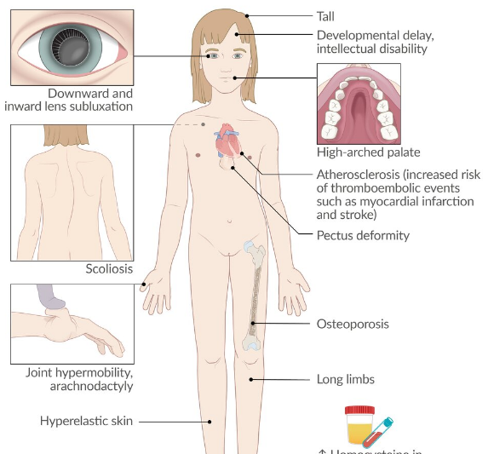

Slide 9
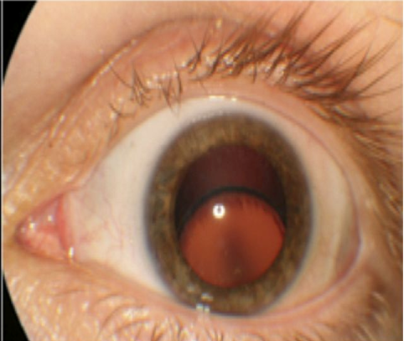
Homocystinemia Lens dislocation

Slide 10
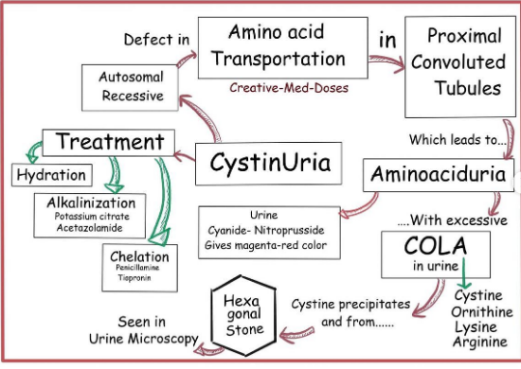

Slide 11
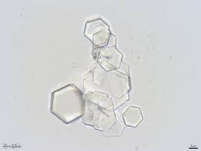
Cystine Hexagonal crystals

Slide 12
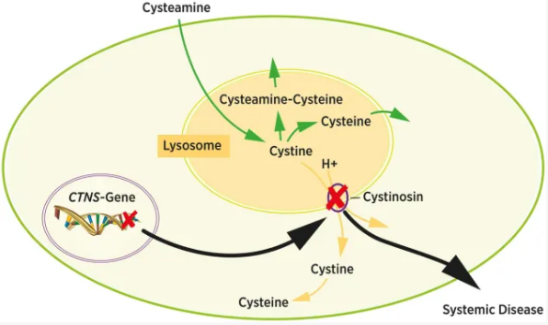
Cystinosis (Cystine storage disease)
Deposition of cystine crystals in the lysosomes.
Cystine accumulates in liver, spleen, bone marrow, WBC, kidneys, cornea and lymph nodes.

Slide 13
Cyanide-nitroprusside Test
It is a screening test. Urine is made alkaline with ammonium hydroxide and sodium cyanide is added.
Cystine, if present, is reduced to cysteine. Then add sodium nitroprusside to get a magenta-red coloured complex. The intensity of colour is proportional to free –SH content.
Specific aminoaciduria may be confirmed by chromatography.

