Slide 1
AROMATIC AMINO ACIDS METABOLISM
TRYPTOPHAN
Aromatic
Essential amino
Nonpolar
Indole ring
Glucogenic and Ketogenic

Slide 2
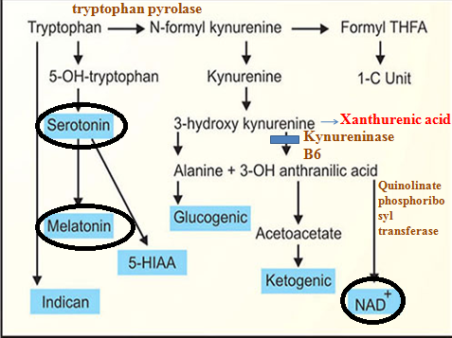

Slide 3
Vitamin B6 deficiency can lead to pellagra.
Vitamin B6 deficiency can lead to Xanthurenic acid excretion in urine.
B6 is cofactor for kynureninase
kynureninase require for conversion of 3-OH Anthranilic acid to Niacin
Niacin production decreases - Pellagra.
Accumulation of kynurenine.
Xanthurenic acid excretion in urine.
Maize eating population can develop pellagra.
Tryptophan deficiency is absent in maize
97% molecules-Alanine & Acetoacetate
3% molecules- Niacin &NAD+

Slide 4
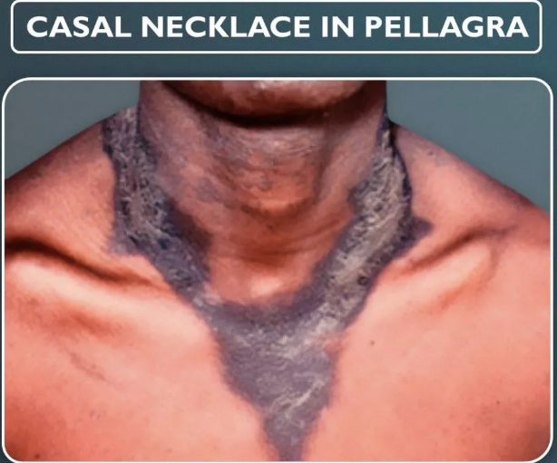
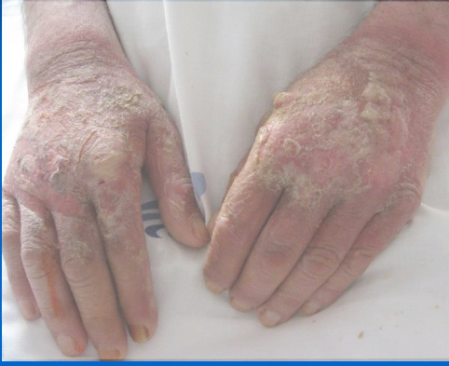

Slide 5
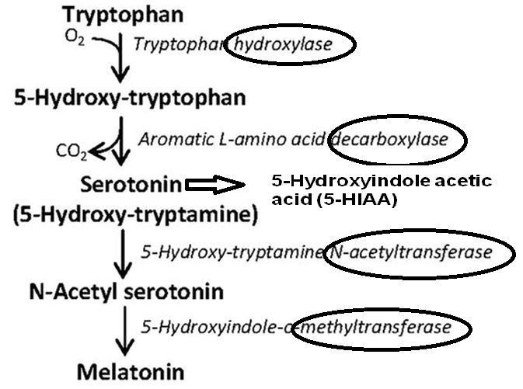
Formed in pineal gland
Diurnal variations, sleep wake cycles & biological rhythms

Slide 6
Serotonin
Site of Synthesis & Action
Brain- mood, sleep, appetite and temperature regulation, stimulator of cerebral activity, calming effect and anti depression
Gastrointestinal tract mucosa- contraction of smooth muscles, Increase motility, Diarrhea
Mast cells-inflammation and allergic reactions
Vasoconstriction in injured vessels, vasodilatation at inflammation site/intact small
Platelets- Aggregation

Slide 7
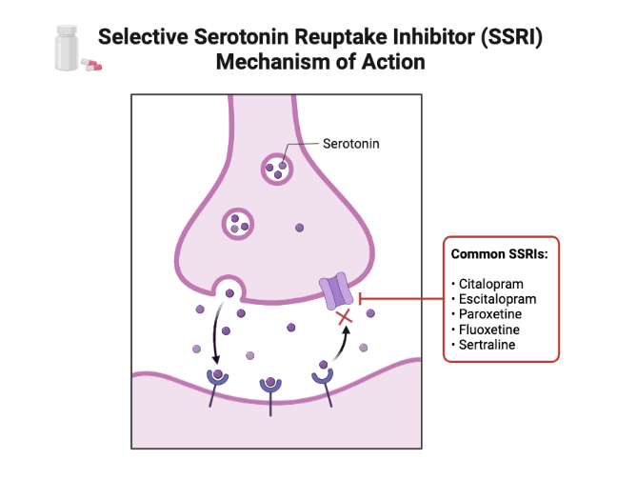
SSRI in the treatment of depression.

Slide 8
MAO Inhibitors in the treatment of depression
Action of MAO
Serotonin to 5-hydroxy indole acetic acid (HIAA) .
Epinephrine to VMA
Action of MAO Inhibitors
block the enzyme monoamine oxidase
Prevent breaks down neurotransmitters like serotonin, dopamine& nor epinephrine.
Increases the levels of these neurotransmitters in the brain

Slide 9
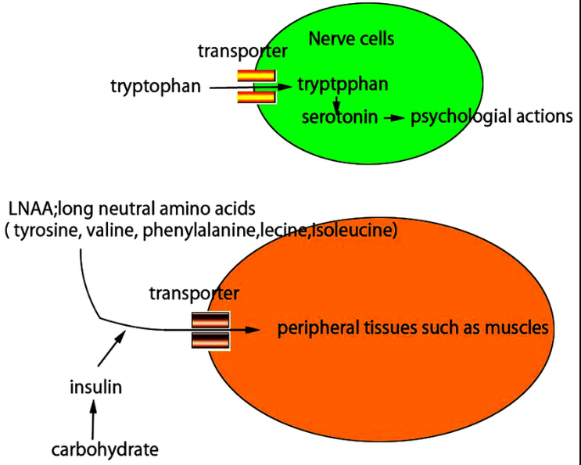
Protein rich food causes alertness, carbohydrate rich diet causes sleepiness

Slide 10
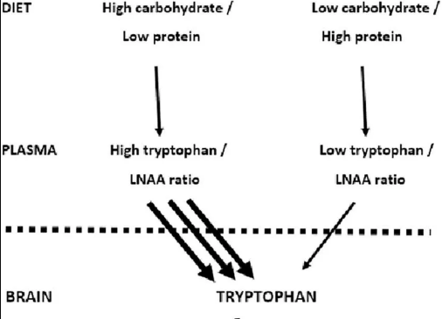

Slide 11
Protein rich diet- increase amino acids in blood.
Competition between all large neutral AA in brain cells for single transporter .
Tryptophan bulkiest amino acid-taken up very slowly-less Tryptophan-less serotonin-less sleep.
However, when carbohydrate rich diet is taken, insulin secretion is increased
Insulin lowers amino acid concentration in blood.
So tryptophan easily enters the brain cells. More Tryptophan-more serotonin-induce sleep

Slide 12
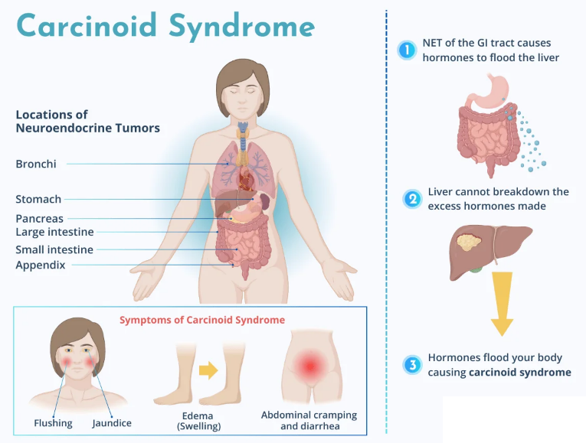

Slide 13
Carcinoid Tumors
Site
Argentaffin cells of the gastrointestinal tract
Appendix
Bronchi
Symptoms
flushing
fluctuating hypertension
sweating
diarrhea
Pellagra

Slide 14
Normally about 1% of tryptophan molecules are channeled to serotonin synthesis. But in carcinoid tumors, up to 60% is diverted to serotonin. Therefore niacin deficiency (pellagra) may also be seen in carcinoid syndrome.
Normal urinary excretion of 5-HIAA is less than 5 mg/day. This is increased up to 500mg/day. Serum levels of serotonin is also elevated.
HIAA estimation: Serotonin is found in some fruits like banana and tomato. For the HIAA estimation, patient is asked to abstain from such fruits and from drugs like indomethacin having the indole ring. 24-hour urine sample is collected.

Slide 15
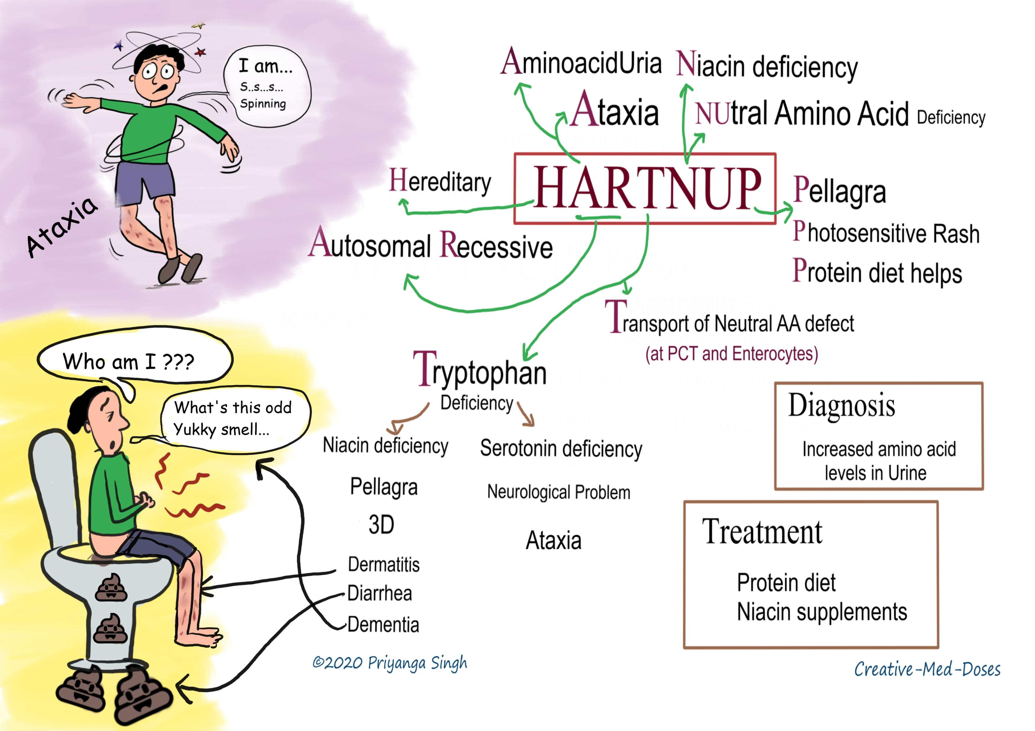
Obermeyer test- indole group

Slide 16
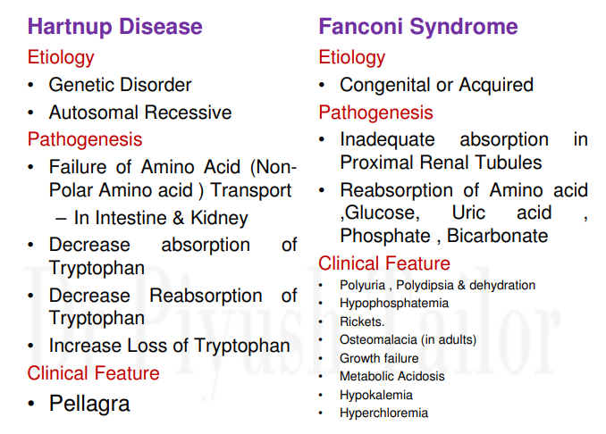

Slide 17


