Slide 1
Micro RNA
Dr Piyush Tailor
Professor and Head
Government Medical College
Bhavnagar

Slide 2
RNA Silencing (Interferenc) family
Micro RNA = miRNA = Endogenous
Small Interfering RNA = siRNA = Exogenous

Slide 3
RNA Silencing (Interferenc) family
20 – 25 Nucleotide
Non Coding Sequence
No Protein synthesis
Negative Regulation of The Gene
Break m-RNA
Repress the translation of m-RNA

Slide 4
Dicer = Endogenous Enzyme – Ribonuclease RISC = RNA Induce Silencer Complex

Slide 7
Natural Immune System
Defense against
Retroviruses =HIV
Information Store in
dsRNA.

Slide 8
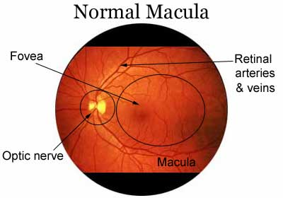
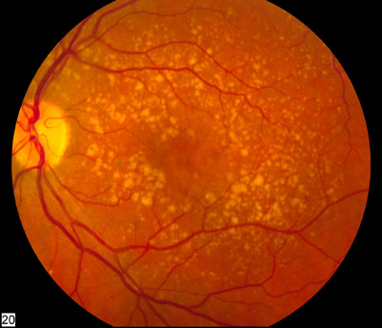
Age related Macular Degeration (AMD)
Blindness

Slide 9
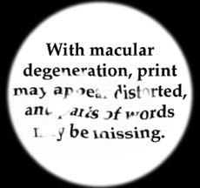
Visual blurring

Slide 10
Very High --- Vascular Endothelial Growth Factor (VEGF)
VEGF --- Increase blood vessel growth.
Excess blood vessels behind the retina - Blurring of Vision
siRNA —dsRNA (as drug)- injected into the eye
specifically targets the mRNA of VEGF.
Destroy hundreds of mRNA,
So Suppression VEGF Synthesis

Slide 11
Youtube Link
Gene Silencing by microRNAs (youtube.com)
Explained! 2024 Nobel Prize in Physiology or Medicine. What is microRNA mediated gene regulation? (youtube.com)

