Slide 1
Sickle Cell Trait with
Pulmonary Tuberculosis
With
Diabetes mellitus
by Group = 15
  71 –Pooja parmar
  72- Shivani parmar
  73- Parth gunvant kumar
  74- Soham Patel
  75- Arjvi Patel
  Dr.Piyush
  Dr Dipti Karbhari

Slide 2
History of patient-
Presenting a case of 20 years old female admitted in J- 4 ward of new civil hospital surat.
Date- 20 th january 2017.
Referred from SMIMER hospital.

Slide 3
Chief complaints
Breathlessness
Ascites
Congestive spleenomegaly
Pain in knee joint
Difficulty in walking
Edema over legs
Swelling over face
Yellowish Discolouration on skin
All Complain was there since 15 days.
Past history Tuberculosis and taking Treatment.

Slide 4
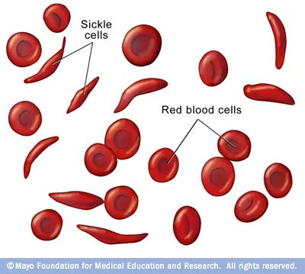
Sickle cell trait
Trait = Mutation in one gene only
Disease = Mutation in both gene
It is always hereditary (from birth)
Patient remains Asymptomatic.
Patient suffer from Symptoms
  1.severe physical stress.
  2.Acute infection..
  3. Bone infacts = Pain = Due to inadequate blood supply
  4. Asceptic necrosis
  5 .Hepatospleenomegaly = Over Work of Erythropoietic system

Slide 5
Sickle Trait provides resistance to malaria
Sickle cell trait provides resistance to malaria.
Malaria is a parasitic disease cause by plasmodium falciparum in africa .
Malaria parasite spends a part of its life cycle in erythrocytes, increased lysis of sickled cells inturupt the parasite cycle.

Slide 6
Biochemical Explaination of Sickle Cell Disease
Single nucleotide alteration ( point mutation )
Beta globin gene of Hb
Thymine for adenine (GAG to GTG) at the 6th codon of beta gene.
Change encodes valine instead of glutamic acid in the 6th Amino acid of beta chain of Hb.
The charge at this site is altered and allows for polymerisation of Hb under condition of hypoxia.

Slide 7
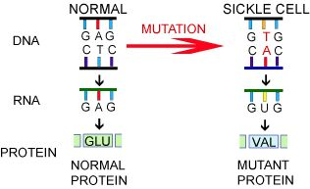

Slide 8
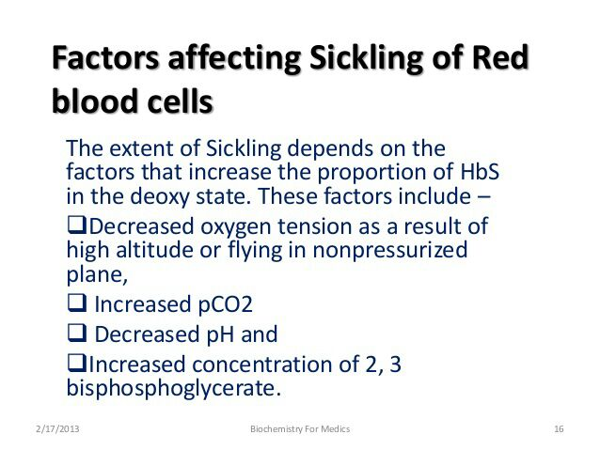

Slide 9
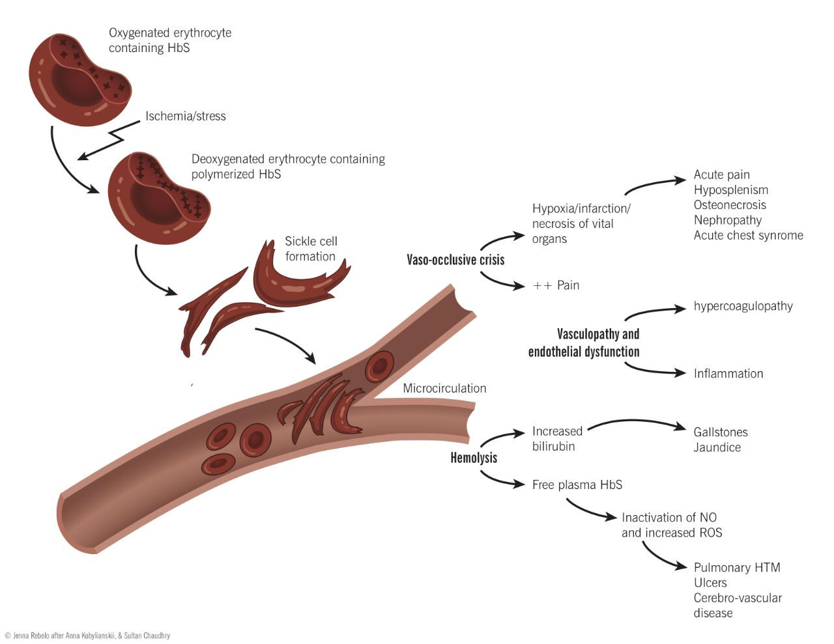

Slide 10
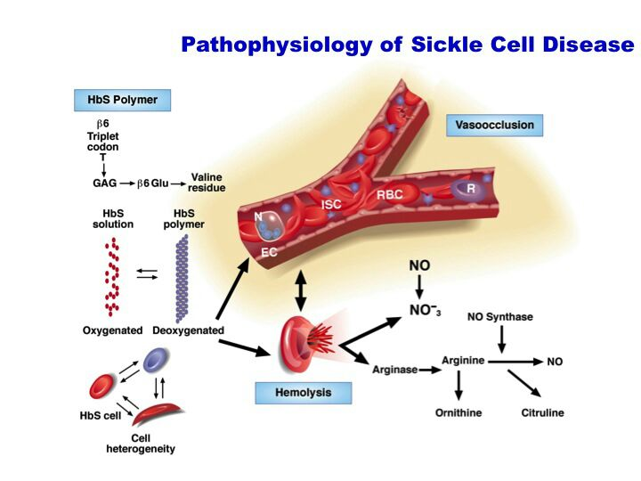

Slide 11
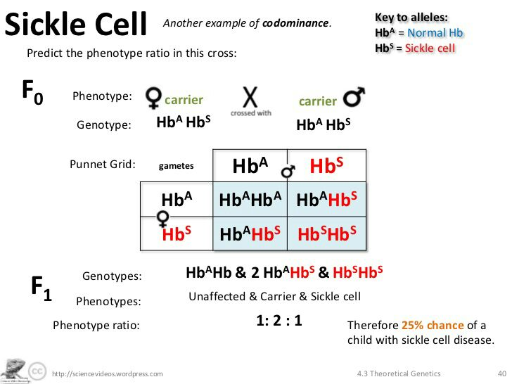

Slide 12
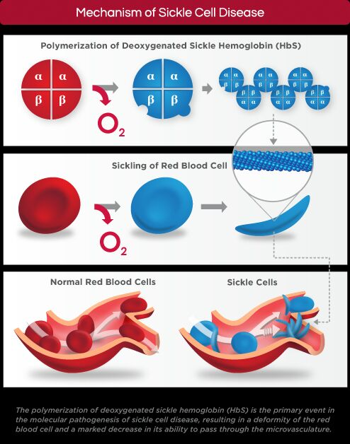

Slide 13
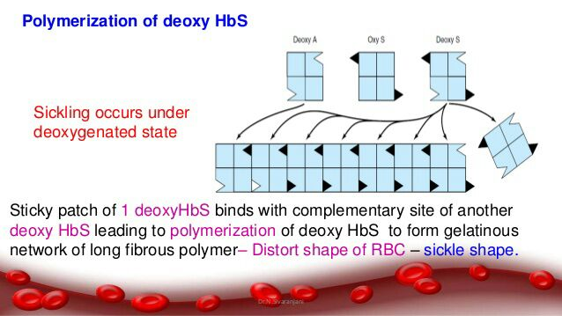

Slide 14
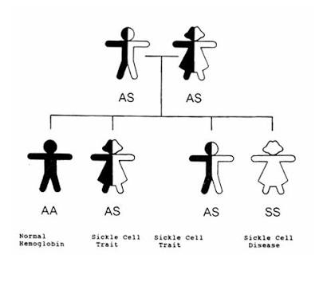

Slide 15
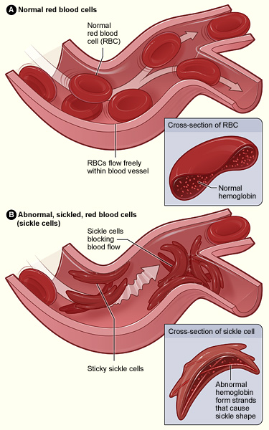
Normal and Sickled Red Blood Cells in Blood Vessels

Slide 16
Biochemistry Section
Sample type- Blood [serum,plasma] Date-21/01/17
Examination [test] | result | Reference range | alert
Hypoproteinemia Due To “” Tuberculosis””
Total protein | 5.8 | 6.42-8.3gm/dl | Low abnormal
Albumin | 2.1 | 3.5-5.2gm/dl | Low abnormal
Haemolysis occur only during crisis
Bilirubin direct | 0.2 | <0.4mg/dl | -
Bilirubin total | 0.6 | <1.3mg/dl | -
Bilirubin indirect | 0.4 | <1.3mg/dl | -
creatinine | 0.6 | 0.8-1.3gm/dl | -
K+ | 3.64 | 3.5-5.1mmol/L | -
Na+ | 131.42 | 136-145mmol/L | Low abnormal

Slide 17
Date | Examination[Test] | Sample detail | result | Reference range | alert
21/01/17 11:00pm | glucose | random | 170 | F:74-100 PP:<140 R:<200mg/dl | High abnormal
22/01/17 7:15am | glucose | fasting | 170 |  | High abnormal
22/01/17 3:44 pm | glucose | Post_prendial | 95
24/01/17 8:12am | glucose | fasting | 106 |  | High abnormal
24/01/17 3:36pm | glucose | Post_prendial | 136 |  | High abnormal
26/01/17 7:15am | glucose | fasting | 70 |  | Low abnormal
26/01/17 4:45pm | glucose | Post_prendial | 60 |  | Low abnormal
27/01/17 4:30pm | glucose | Post_prendial | 99

Slide 18
date | Examination[test] | result | Reference range | alert
22/01/17 | ketones | negative | N/A N/A | -
24/01/17 | Cholesterol total | 119 | <200mg/dl | -
24/01/17 | trigylcerides | 178 | <150mg/dl | High abnormal
24/01/17 | LDH | 544 | <360U/L | High abnormal

Slide 19
What other investigation like to do with this case?
For Diagnosis of Tuberculosis
  Sputum Culture
  Montex Test
  Imaginary Study
Sickle Cell
    Dithionet test
      Turbido metery test- it is used to find the no. of cells in a solution.
    Hb Electrophoresis.
    HPLC

Slide 20
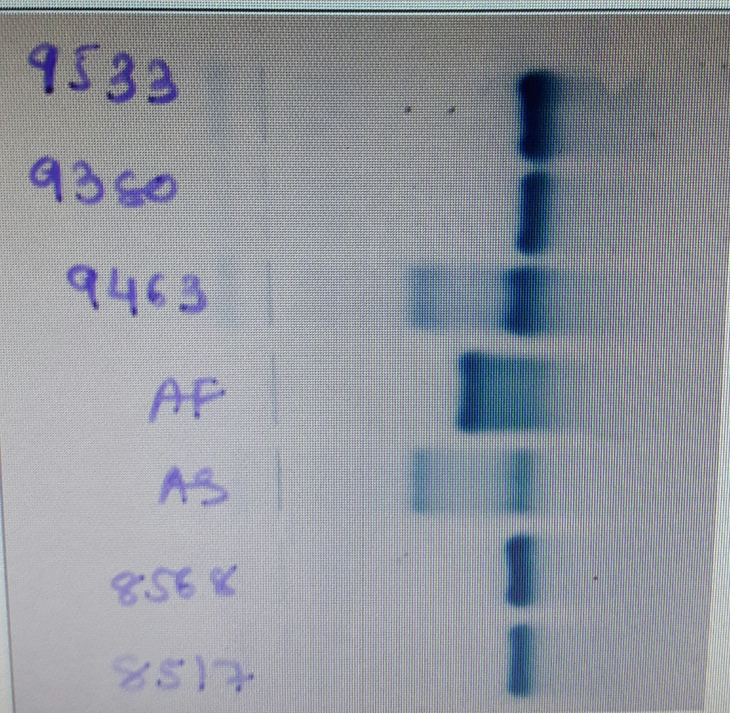

Slide 21
More Electrophoresis
As an example,considered Hb the O2 carring protien in the blood
Hb as 4 polypeptide subunits 2Alpha & 2 Beta
Most people homozygous for the HbA Beta subunits
The HbS allele is common in west africa(It confers Malaria resistence)
HbS has an uncharged valine in case of negatively charged glutamic acid found in HbA

Slide 22
Understanding Of Electrophoresis
HbA
Glutamic acid
Negative Charge
Move More Distance
HbS
Valine
Neutral Charge
Move Less Distance

Slide 23
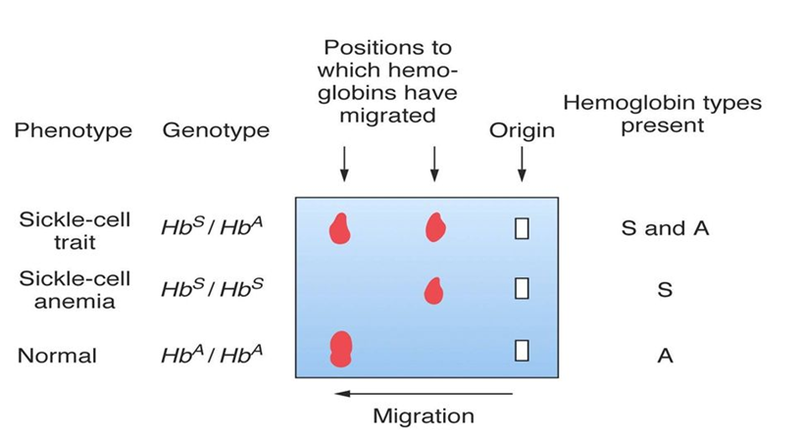

Slide 24
Dithionite test
Inexpensive
Rapid
Convenient
The reagent consists
  Saponin.
    Make RBC Haemolysis
  Na-dithionite
    Hb deoxygenates,
    Haemoglobin Polymerazition
    Turbidity of The Sample
Positive Test show Turbidity

Slide 25
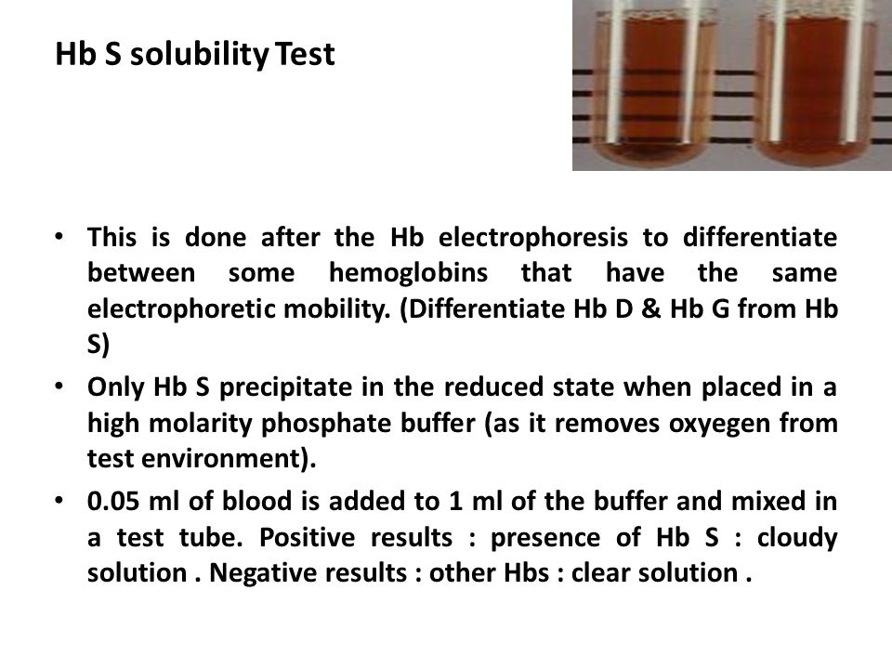

Slide 26
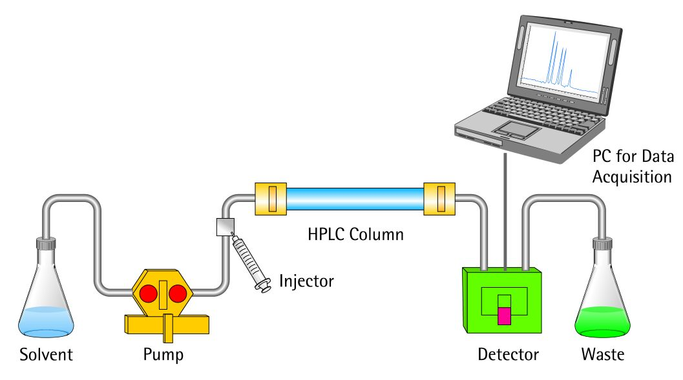
HPLC TEST

Slide 27
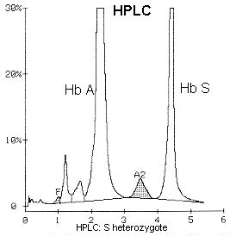

Slide 28
What is treatment of sickle cell disease & Trait
Hydroxyurea
Oxygenation
Hydration

Slide 29
Hydroxyurea
Induce gene for gamma globin chain
5 to 10 fetal Hb synthesis
Interfer with polymerization of deoxy HbS
Prevent crisis and improve oxygenation

Slide 30
Oxygenation therapy
More oxygen
Less deoxygenated Hb
Decrease in polymerization
Decrease in lysis of RBC

Slide 31
Hydration
Increase in water intake
Increase in body fluid
Increase in circulation
Increase in oxygenation
Decrease polymerization
Decrease in lysis of RBC

Slide 32
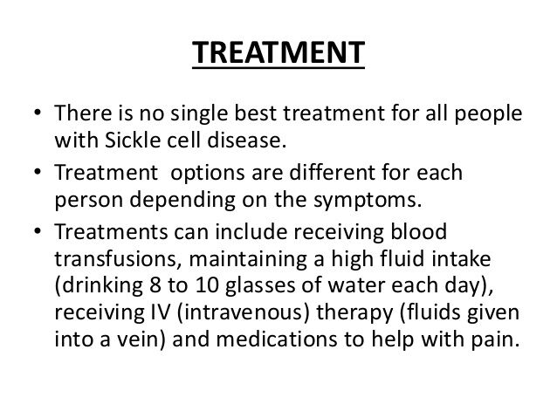

Slide 33
What is tuberculosis ?
It is most prevalent communicable infectious disease caused by Micobactarium tuberculosis
It mainly affects the lungs but can spread to otherparts of the body

Slide 34
How long do TB bacteria stay alive?
Stay alive in the unfresh air for few hrs.
Can’t survive in fresh air & sunlight

Slide 35
How you get TB?
The patient of TB of lung coughs, sneeze, talks,droplets containing the bacteria are released into air…….

Slide 36
Symtoms of TB
Bad cough- minimum for 2 weeks
Pain in chest & they may cough up blood
Fever
Chills
Night sweats
Loss of appetite
Weight loss and fatigue

Slide 37
Diagnosis of TB
Based on :
1. Chest Examination
2.Microscopic Examination(Sputum Exa.)
3.Culture of body fluid

Slide 38
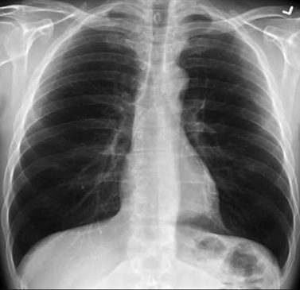
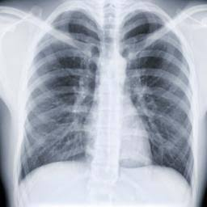
Chest Radiography

Slide 39
1.Sputum Examination
Are essential to confirm TB best collected in morning before any meal
Sputum examination for 3 days
Sputum can be collected from laryngeal swab, or Bronchial washing
Smear should be prepared from thick dirty part of sputum
Stain with Ziehl-Neelson technichque

Slide 40
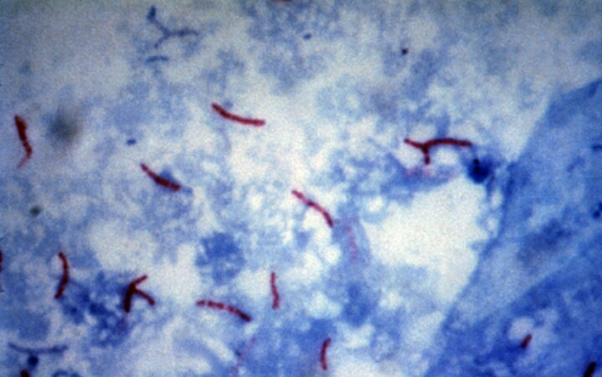

Slide 41
Clinical presentation of TB
Chest Radiograph:
  Congestion
  Patchy or Nodular infiltrates
CT scan:
  To detect lung cavities caused by TB
MRI:
  This test looks for TB in the brain or the spine
  For Pulmonary & Extra-Pulmonary TB

Slide 42
Treatment of TB
Always treat with multiple drugs , Never add a single drug to a failing regimen
Treatment course depends on the categories of the patients
Usually 6 months, sometimes 9 months
4 drugs for 2 months:
  1. Isoniazid
  2. Rifampicin = Red Colour Urine
  3. Ethambutol
  4.pyrazinamide
Two drugs for 4 or 7 months:Isoniazid & Rifampicin

Slide 43
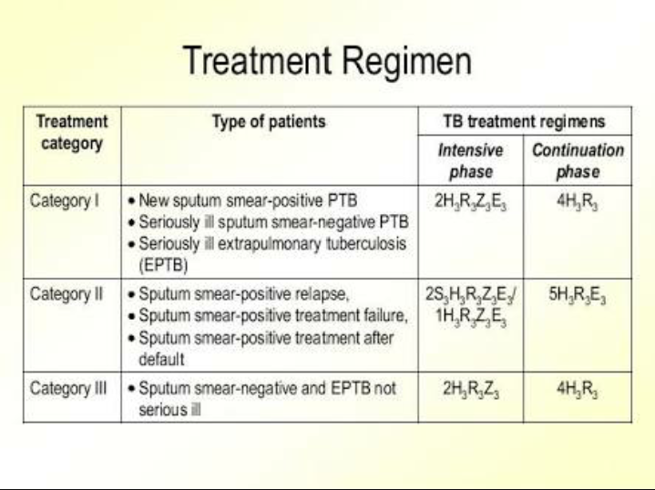

Slide 44
Other Investigation need to evaluate DM
Serum Insulin
Serum C-peptide
Glycated hemoglobin HbA1c

Slide 45
Diabetes Mellitus
Type 1= Insulin dependent diabetes melitus
  1.Autoimmune (Islet cell antibodies)
  2.Distruction of beta cells of pancreas-little or no insulin production
Requires daily insulin administration
May occur at any age usually appears below age 15 yrs

Slide 46
Type 2:NIDDM:
  1. caused by disturbance in insulin reception in the cells- decrease in numbers of insulin receptors
  2. Loss of beta cells responsiveness to glucose leading to slow or decreased insulin released by the pancreas
Occurs at the age >40yrs but can also occur in children

Slide 47
Pre-Diabetes
Impaired fasting glucose
-FBS- 100 to125 mg/dL
Impaired glucose tolerance
-OGTT 140 to 199 mg/dL
HbA1c 5.7-6.4%

Slide 48
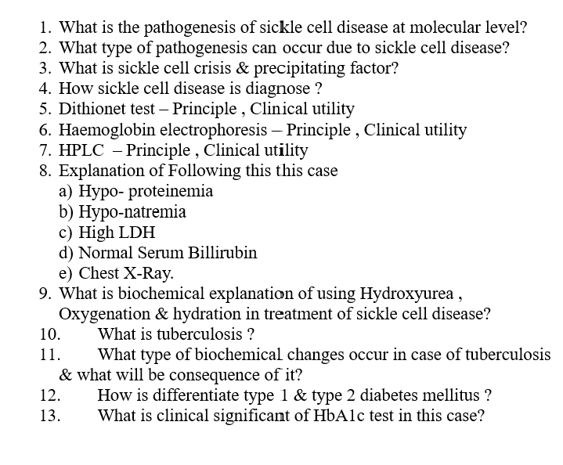
What we have learned ?

Slide 49


