Slide 1

NATIONAL ACCREDITATION BOARD FOR TESTING & CALIBRATION LABORATORIES
Mansi Gondaliya
Shraddha Saripadiya
Suman Gavit
Vikas Patel
Sagar Indve
Mahendra Ahir

Slide 2
NABL
National Accreditation Board for Testing and Calibration Laboratories
Under QCI of Government of India
The accreditation of medical laboratories are granted according to requirement of
  ISO 15189:2012
  NABL 112

Slide 3
General information
NABL web site www.nabl-india.org/
How to find ISO 15189:2007 https://www.iso.org/standard/42641.html
How to find ISO 15189:2012 https://www.iso.org/standard/56115.html
How to find NABL-112
www.nabl- india.org/nabl/file_download.php?
filename=201207131010-NABL-112...

Slide 4
How to find NABL Document
www.nabl-india.org/
Publication(home page)
NABL document (all list )
153 Application form for Medical Testing laboratories
208 Pre-Assessment Guidelines & forms

Slide 5
ISO of Different category
ISO15189 - How to Manage Quality of Medical Laboratories
ISO9000 - Definition of Quality Management
ISO9001 - How to Manage Quality of Any System
ISO17025 - How to Manage Quality of Testing & Calibration of
Laboratories

Slide 6
Full forms
NABL – National Accreditation board for testing and calibration laboratories.
NABH - National Accreditation board for hospitals and health care providers.
MRA – Mutual Recognition Agreement
ILAC – International laboratory accreditation cooperation.
APLAC – Asia pacific laboratory accreditation cooperation.
LIS – laboratory information science.
IQC – Internal quality control.
EQAS – External quality assurance scheme.
ILC – Inter Laboratory Comparison
ISO – International organization for standardization
11.QCI – Quality council of India

Slide 7
13. IEC – International electro-technical commission.
14. WDI – Work Desk Instruction
15. SOP – Standard operating procedures.
16. TRF – Test Request Form
TAT – Turn around time.
CLIA – clinical laboratory improvement amendment.
CLSI – clinical and laboratory standards institute.
CV – Coefficient of variation
SD – Standard Deviation
TE - Total Error
TAE – Total Allowable Error
CAB – Conformity Assessment Bodies
QM- Quality manager
TM- Technical manager
LD- Laboratory director.

Slide 8
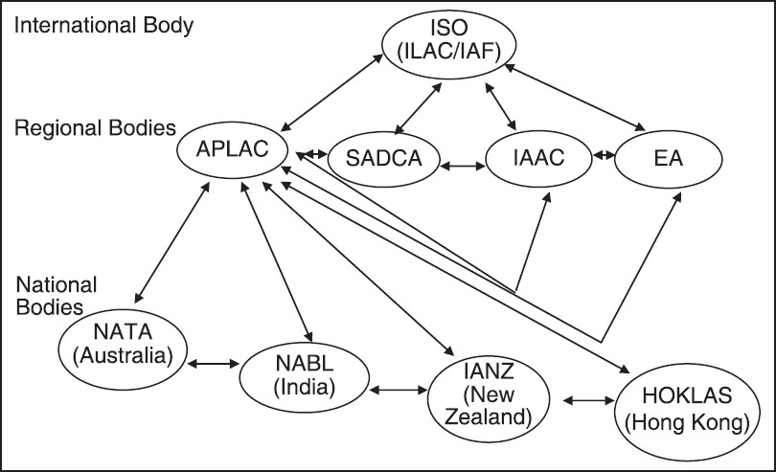
MRA

Slide 9
Mutual Recognition Agreement
ISO (ILAC), APLAC and NABL are interconnected.
ISO,APLAC,NATA & NABL linked to the same standardization (ISO) in testing procedures.
MRA indicate synchronization of standard requirement between all bodies.
Example….
ISO – laboratory personnel should be competent for intended purpose.
NABL – MLT , B.Sc. , M.Sc
NATA - depend on their respective country criteria.

Slide 10
Scope of NABL Accreditation
Testing laboratories
Calibration laboratories
Medical laboratories

Slide 11
Scope of NABL Accreditation
TESTING LABORATORIE STERIAN | CALIBRATION LABORATORIES | MEDICAL LABORATORIES
Biological Chemical Electrical Electronics Fluid-Flow Mechanical Non-Destructive Testing Photometry Radiological Thermal Forensic | Electro-technical Mechanical Fluid Flow Thermal & Optical Radiological | Clinical Biochemistry Clinical Pathology Haematology & Immuno-haematology Histopathology Cytopathology Genetics Nuclear Medicine (in-vitro tests only)
Proficiency Testing Providers |  | Reference Material Procducers
Testing Calibration Medical Inspection |  | Chemical Composition Biological & Clinical properties Engineering properties Miscellaneous Properties

Slide 12
Calibration laboratories
Electro-Technical
  Electric current
  Magnetic field
Mechanical
  Speed
  Rotation
Radiological
  X rays illustration management
Thermal
  Temperature
Optical
  Light wave length
Fluid-Flow
  Flow rate

Slide 13
Preparation of CAB before applying for NABL Accreditation
Four days Internal Audit training for Technical staff
and authorized signatory
Training for all laboratory personnel.
Define Organigram of Laboratory
Appoint quality manager who has done “Internal
Auditor Course as per ISO:15189:2012.”
Designate QM, TM & LD
EQAS & IQC for all parameters
Preparation of Quality Manual / Quality System

Slide 14
Preparation of CAB before applying for NABL Accreditation
Define Quality Policy & Objective Finalization
Documentation & Implementation of Process –
Procedure (Quality System Procedure)
Preparing SOP and WDI related to different process
Internal Audit - Gap Analysis - Gap filling
Management Review Meeting
Corrective – Preventive Actions
Process to NABL

Slide 15
Information About Laboratory Required by NABL
Name of Authorized signatory
  - Qualification , Experience , Training
Organigram
Quality Manual
Scope of accreditation (Test)
- Name of Method ,Name of Test/Principle/Range of Testing
Information about Instrument
- Calibration & Manufacturer
Quality Control Material
- Lot number , CV%
Reference / Control Material
- Provider , Lot number

Slide 16
Benefits of Accreditation
Promise to clients about good laboratory practice
National and international recognition
4. Provides global similarity
5. Provides comparability in measurements of test results
6. Doctors can rely on test results
7. Improve staff motivation for work with system.
8. Confidence in the event of legal challenge
9. Saves money by putting system in work for good service.

Slide 17
ACCREDITATION PROCESS
Application for Accreditation
(by Laboratory)
Feedback
to
Laboratory
and
Necessary
Corrective
Action
by
Laboratory
Acknowledgement & Scrutiny of Application
(by NABL Secretariat)
)
Adequacy of Quality Manual
(by Lead Assessor)
Pre-Assessment of Laboratory
(by Lead Assessor)
Final Assessment of Laboratory
(by Assessment Team)
Scrutiny of Assessment Report
(by NABL Secretariat)
Recommendations for Accreditation
(by Accreditation Committee)
Approval for Accreditation
(( by Chairman NABL)
Issue of Accreditation Certificate
(by NABL Secretariat)

Slide 18
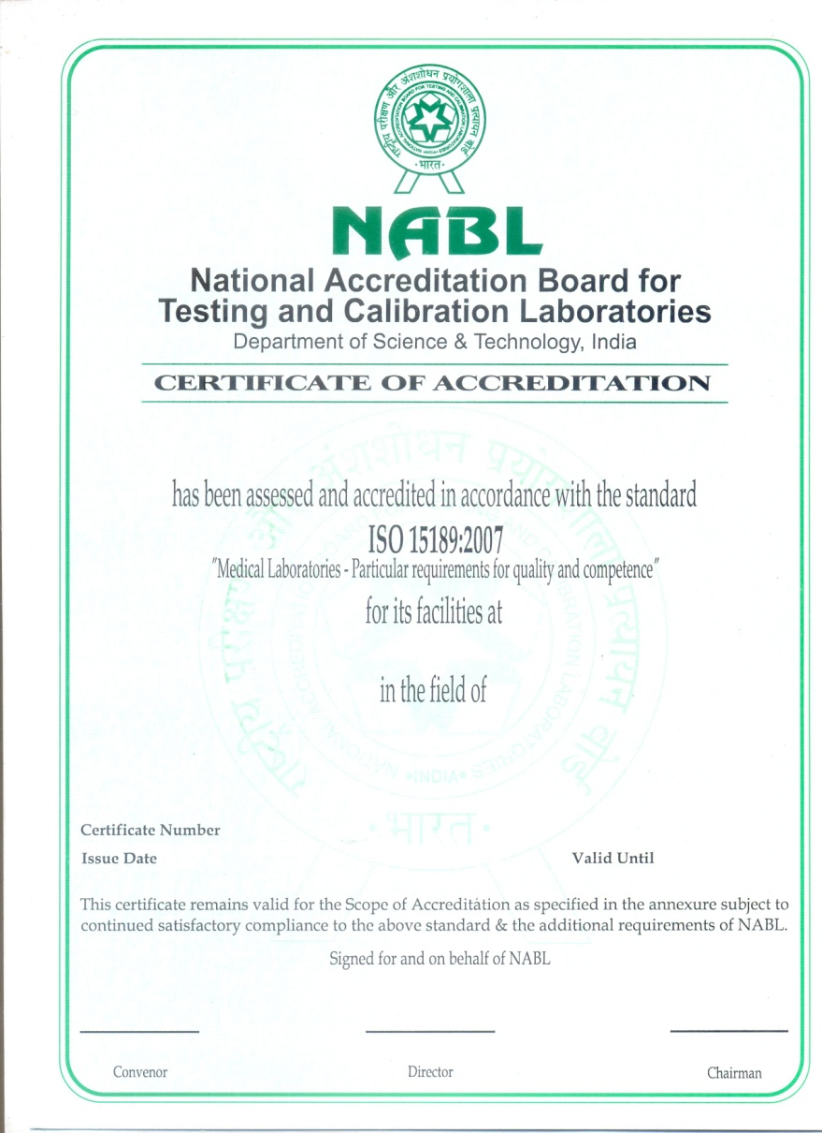
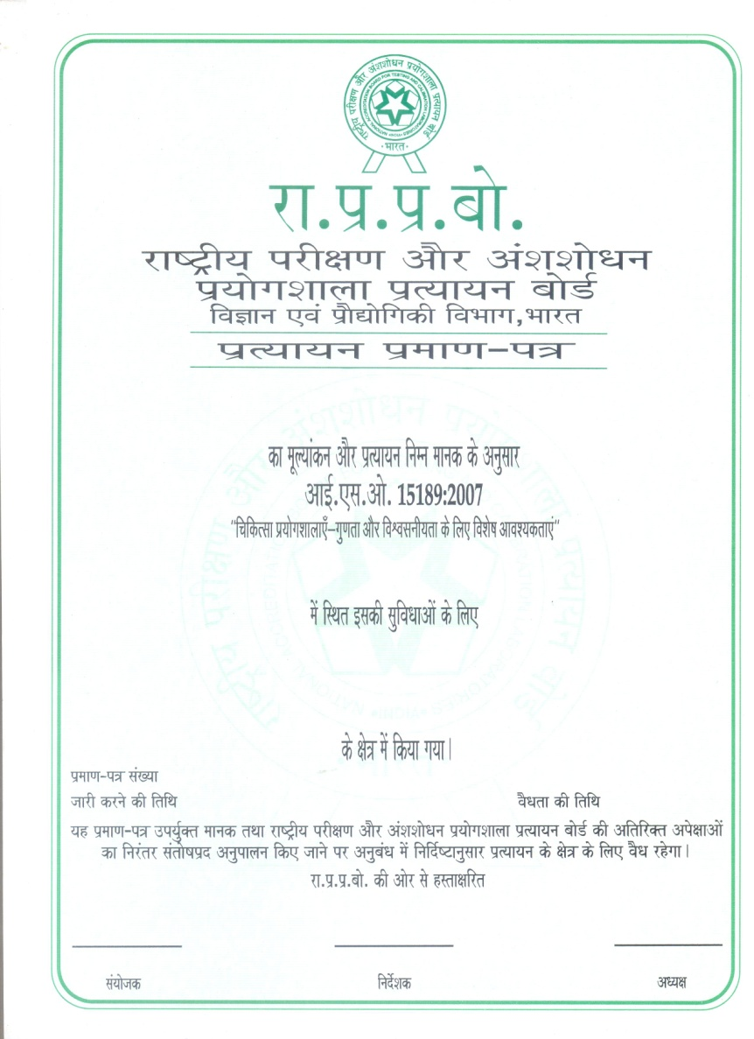
Accreditation Certificate

Slide 19
Other definitions
Accreditation
Procedure by which an authoritative body (NABL) gives formal recognition that an organization (Laboratory)is competent to carry out specific tasks .
Quality
Degree of fulfillment of specific characteristic with specific criteria.
For Glucose, Total allowable error as per CLIA is <10%
Biochemistry laboratory has TE of 5% for glucose

Slide 20
Quality Management System
QMS is to direct and control an organization to maintain quality.
It is document to control and direct all process like the pre-examination, examination and post-examination processes.
Quality policy
Overall intentions and direction of a laboratory related to quality
Formal promise
“New Civil Hospital Laboratory Services Surat” (NCHSLS) is committed to provide accurate, reliable and timely medical laboratory services.

Slide 21
Inter laboratory comparison
To compare test value with other laboratory to check performance and evolution.
For example,
Compare Glucose value with SMIMER hospital laboratory.
Randox EQAS programme
In this programme more than 1000 laboratory participate.
Laboratory reports is compare with all this laboratories .

Slide 22
CAL | less_than | 6.5
CHE | less_than | 3000
GLC | less_than | 55
GLC | less_than | 30
IBIL | more_than | 15
K | less_than | 3
K | more_than | 5.5
TBIL | more_than | 15
Critical interval
Interval of examination results for test that indicates an immediate risk to the patient.

Slide 23
Biological reference interval or Reference interval
specified interval of values taken from a biological reference population.
For example, RBS reference interval = 70-140 mg/dl,
Abnormal RBS = > 140 mg/dl,
Critical RBS = > 300 mg/dl.
Documented procedure
Documentation of specified way to carry out any activity or a process.
For example, documentary procedure for performing ADA test.

Slide 24
Nonconformity
Nonfulfillment of a requirement
For example,
Internal quality control value for Glucose goes out of 3 SD.
Laboratory technician got needle pick injury during blood collection.
Point-of-care testing (POCT)
Near-patient testing
Testing performed near or at the site of a patient
Example : Glucometer

Slide 25
Clauses & Sub clauses
4.1 Organization and management
Guideline about
  legal identity
  registration of organization
  ethical issues
  responsibility of different laboratory person.
4.2 Quality management system
What to write QMS.
  document, procedure, WDI,
Organization chart

Slide 26
4.3 Document Control
Labeling and identification of different document.
all documents are identify to include,
  Title
  Unique identifier on each page;
  The date of current edition and/or edition number
  Page number to total number
  Authority of issue.
4.4 Review of contracts.
It is related to agreement with customer(patient), user and doctor.
  Which test can be done or not done
  Which procedure
  when report available = TAT
  how report will be available.

Slide 27
4.5 Examination by referral laboratories
About selection and evolution of referral laboratory.
4.6 External services and supplies
Procedure for how to purchase equipment, consumable reagents.
4.7 Advisory services
About interpretation of result, scientific review.
4.8 Resolution of complains
Procedure to respond complain and feedback.
4.9 Identification and control of nonconformities(refusal)
Procedure for identification and immediate action , corrective action, preventive action and authorized person to response NC.
4.10 Corrective action
To eliminate cause of nonconformities.

Slide 28
4.11 Preventive action
For prevention of nonconformities.
4.12 Continual improvement
Add new test, decrease TAT, improve techniques, improvement more specific result.

Slide 29
4.13 Quality and technical records
records shall include at least the following;
Staff qualifications, training and competency records;
Request for examination
Records of receipt of samples in the laboratory
Examination results and reports;
Instrument maintenance records,
Calibration functions and conversion factors;
Quality control records;
Nonconformities identified and immediate or corrective action taken;
Complaints and action taken;
Records of internal and external audits;
Interlaboratory comparisons of examination results;

Slide 30
4.14 Evaluation & Audits
Plan & implement to the internal audits
Patient& doctors feedback
Staff suggestion
Internal Audit
  Self evaluation of laboratory about technical and management requirement as per ISO 15189:2012 & NABL 112
Risk management
Quality indications
  IQC & EQAS
  TAT
  Sample flow
Reviews by external organization
4.15 Management review
Management meet with N.C. related to management
Role of management to resolve this N.C.
Discussion about Risk management & Continueal improvement

Slide 31
Technical requirements
5.1 Personnel
Personal qualification
The laboratory provide training for all personnel :
  The quality management system;
  Assigned work processes and procedure;
  The applicable laboratory information system;(LIS)
  Heath and safety, including the prevention or containment of the effects of adverse incidents;
    Needle pick injury
    BMW management training
    Mercury spillage as well as sample spillage
    Fire extinguisher training
  Ethics;
  Confidentiality of patient information.

Slide 32
5.2 Accommodation and environmental condition
Staff facility
Patient facility
Testing facility
Storage facility
Disposal facility

Slide 33
5.3 Laboratory equipments, reagents and consumables.
5.3.1. Equipment
- Calibration
- Maintenance
5.3.2. Reagents and Consumer
- Verification
- Validation
- Inventory
- Storage.

Slide 34
5.4 Pre-examination procedures
Request form
Primary collection manual
  Information of patient & users during sample collection.
  Sample collection
  Sample transport
  Sample reception
5.5 Examination procedure
About examination procedures.

Slide 35
5.6 Assuring quality of examination procedure
Related to frequency of IQC and EQAS
Drawing of L J chart
Interpretation of L J chart
Interpretation of ILC
Root cause analysis of IQC & EQAS
5.7 Post-examination procedures
About review of results
Storage, retention and disposal of sample.

Slide 36
5.8 Reporting of results
identification of the examination
identification of the laboratory .
identification of all examinations done by referral laboratory
patient identification and location
Date of primary sample collection
type of primary sample;
Name of procedure,
Results SI units
biological reference range
interpretation of results
Authorized signature
date of the report, and time of release
page number

Slide 37
5.9 Release of results
Technical personnel shall be well trained.
Issues a final report after verifying Results of the tests.
Reports records should be maintain for revise.
5.10 Laboratory information management
Patients security and confidentiality maintain
Access to LIS should be restricted.

Slide 38
CAP ACCREDIATION PROCESS
CAP =College of american pathologist
The CAP does not accrediate portion of laboratories.
The laboratory is awarded a ''CAP Laboratory Accrediation''certificate upon successful completion of the inspection process and becomes part of an exclusive group of more than 7600 laboratories worldwide that have met the highest standards of excellence.

Slide 39
Standard for CAP Accreditation
Standard 1- Director & Personnel
Standard 2- Physical Resources
Standard 3 - Quality Management
Standard 4 - Administrative Requirement

Slide 40
Standard for CAP Accreditation
Standard - 1
Relates to the qualification, responsibility and role of the Director.
Standard - 2
Concerns the Physical resources of laboratory.
Space, Instrumentation, commnication and data processing system, reagent and other supplies, ventilation, piped gases and water, public utilities, storage and waste disposal..

Slide 41
Standard 3 - Encompasses quality management .
System validations.
QC of preanlytic,analytic,and post analytic process
Proficiency testing
Standard 4 - Administrative requirements
Comply with the required specified in the standard in the term of accreditation checklist.

Slide 42


