Slide 1
BIOMEDICAL WASTE MANAGEMENT

Slide 2

Central Pollution Control Board
Ministry of Environment, Forest & Climate Change

Slide 3
Healthcare Waste
A) Bio Medical Waste:-
Patient’s blood, secretions, infected parts, biological liquids such as chemicals, medical supplies, medicines, lab discharge, sharps metallic and glassware, plastics etc.
B) General Waste:-
all the waste other than bio-medical waste.

Slide 4
Bio Medical Waste Management Rules, 2016 categorises
Yellow categories
Red categories
White categories
Blue categories

Slide 5
YELLOW CATEGORIES
Human Anatomical Waste
Human tissues, organs, body parts – Placenta , Aborted fetus
Soiled Waste
Items contaminated with blood, body fluids like dressings, plaster casts, cotton swabs
bags containing residual or discarded blood and blood components.
Discarded or Expired Medicine
Pharmaceutical waste like with glass or plastic ampules, vials.
Chemical Waste & Chemical Liquid Waste
Expiry Laboratory chemical
Laboratory Kit (as per MSDS -Material Safety Data Sheet)
Silver X – ray film developing liquid
Discarded Formalin
Infected secretions & Aspirated body fluids – pleural fluid , CSF . Urine
Liquid from laboratories

Slide 6
2) RED CATEGORIE
Infected Plastic Material
Tubing
Plastic bottles,
intravenous tubes and sets,
catheters,
urine bags,
syringes without needles,
Syring with Fixed needle , only after needles cut
Vacutainer – with blood
Gloves

Slide 7
3) WHITE CATEGORIE
Waste Sharps including Metals that cause puncture and cuts.
Needles, syringes with fixed needles
Needles from needle tip
scalpels, blades
any other contaminated sharp object

Slide 8
4) BLUE CATEGORIE
Broken or discarded and contaminated Glass
Used Medicine vials and ampoules
Expiry medicine vials and ampoules = Yellow category

Slide 9
Radioactive waste
Source
Drugs (cancerous drugs)
Dyes (Iodine & Barrium)
Diagnostic kits (RIA)
Excreta from patient treated with radionuclide substance.
This type of waste has a low level radioactivity.

Slide 10
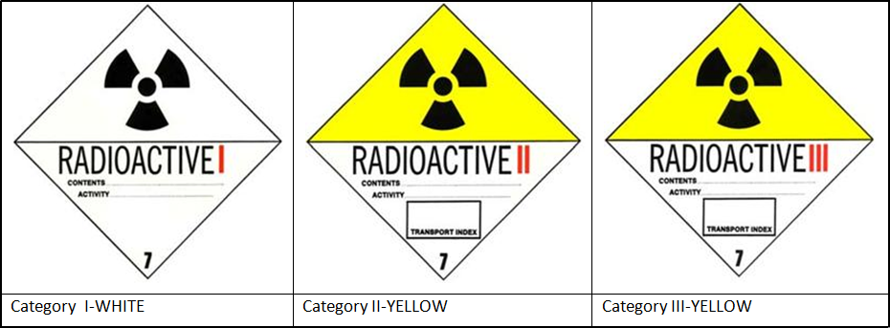
PACKAGING
1.WHITE I-Almost no radiation
max. 0.5 mrem/hr on package surface.
2.Yellow II-low level radiation
max.50 mrem/hr on package surface.
3.Yellow III-high level radiation
max.200 mrem/hr on packag surface.

Slide 11
Disposal management
For disposal of radioactive waste in hospital yellow II type bag is used.
Low level radioactive waste can be sent for landfill.
Low level waste can be stored in depth sea until the radioactivity fallen to safe level.
How will be “radio-active waste transported upto land or sea?

Slide 12
PROCESS FLOW OF BMW
First five steps
Segregation
Collection
Pre-treatment
Transportation
Storage
Final Disposal

Slide 13
SEGREGATING MEDICAL WASTES
Waste must be segregated at the point of generation of source and not in later stages.
“Point of Generation” means the location where wastes initially generate, accumulate and is under the control of doctor/nursing staff etc.
How to Impliment
Separation of Waste as per Different Categories
Training of Staff
Put different colour coded bags / containers
IEC (Information, Education & Communication)

Slide 14
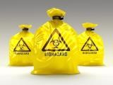
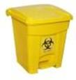
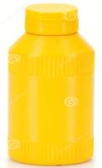

Type of Container/ Bags to be used for Waste Segregation
Yellow Category
Yellow coloured non-chlorinated Plastic Bags

Slide 15

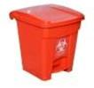
Red Category
Red Colored Non Chlorinated Plastic Bags
Having thickness equal to more than 50 μ

Slide 16
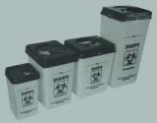
White Category
White Coloured translucent, puncture proof, leak proof, Temper Proof containers

Slide 17


Blue Category
Puncture proof, leak proof boxes or Body containers with blue coloured marking

Slide 18
Bio Medical Waste Collection
Time of Collection:
Disposal of waste within 48 hours.
Packaging:
Bio-medical waste bags and sharps containers should be filled to more than three quarters full.
Plastic bags should never be stapled but may be tied or sealed with a plastic tag or Tie.
Replacement bags available at site of segregation

Slide 19


Colour coded waste bags and containers should be printed with the
bio-hazard symbol,
labelled with details
Such as,date
Type of waste
Waste quantity
Senders name
Receivers details
Bio-Hazard Label
Cyto-Toxic Label

Slide 20
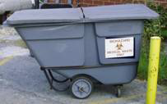
Transportation Trolleys must be closed.

Slide 21
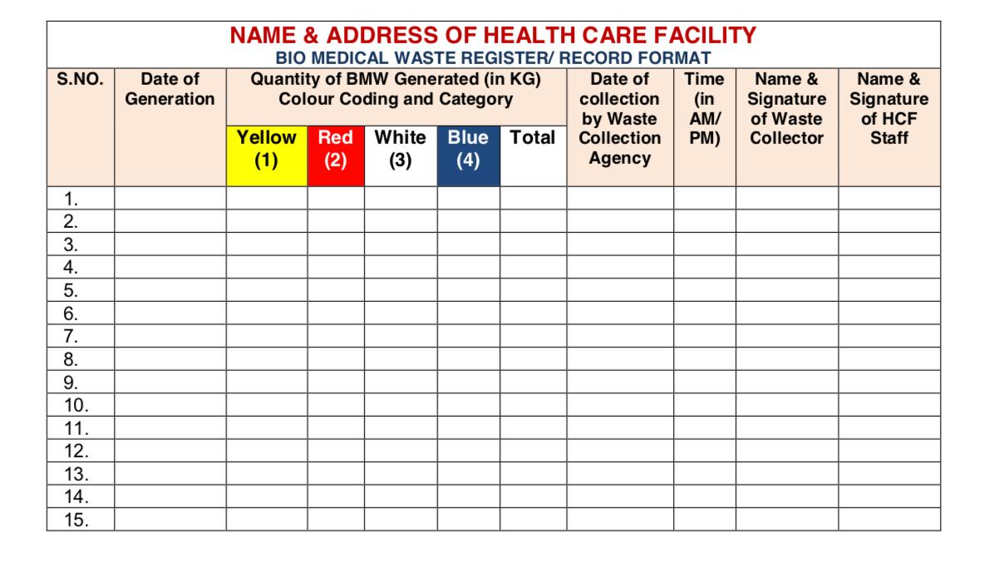
Record Keeping
To maintain the records
Format for Bio Medical Waste Register/Record

Slide 22
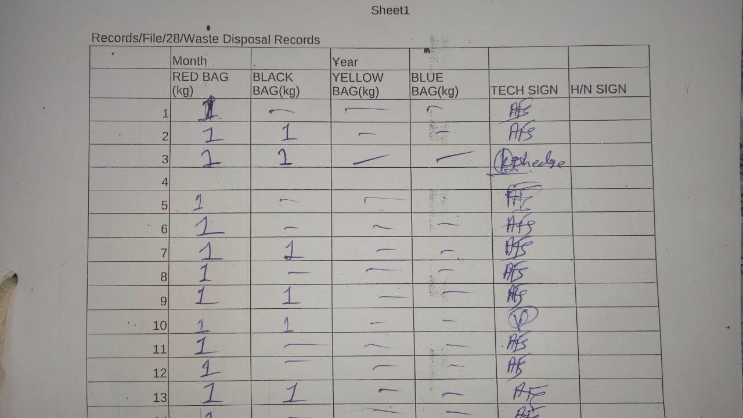
Sample lab record
Find Mistake In Following Record

Slide 23
TRANSPORTATION
Temporary stored at the central storage area of the hospital
Than sent in bulk to the site of final disposal once or twice a day
Point to Care During transportation & at Central storage
  Every bag must have “ Bio Hazard Symbol”
  Kept at Separate area
  Not accessible to unauthorized public
  Properly sealed and labeled.
  Bags should not be over filled.
  Bags can be picked up by the neck again
  Hand should not be put under the bag.
  At a time only one bag should be lifted.
  Manual handling of waste bags should be minimized
  BMW shall not be kept stored for more than 48 hours
Notes:
<number>

Slide 24
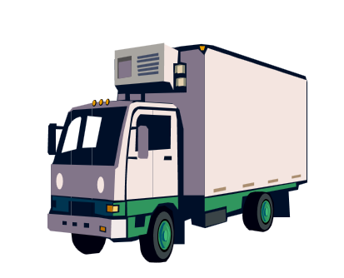
MEDICAL WASTE HANDLING
Three methods
1.By a healthcare professional employed & facility.
2.By contract with a transporter registered.
3.By parcel post, or courier service (sharps only).

Slide 25
Final Treatment
Several methods :-
Incineration
Autoclaving
Plasma pyrolysis
Chemical treatment
Microwave treatment

Slide 26
Incineration:-
High temperature(110-850 C) dry oxidation process.
Generated Ash, flue gas and heat.
Used for the waste that can not be reused, recycled or disposed in landfill site.
Human anatomical waste
Animal waste
Expired medicines
Microbial laboratory waste
Solid waste incinerated.

Slide 27
AUTOCLAVE:-
Treatment of Waste With High & Specific Gas Pressure + Temperature + Time.
As the water molecules converted in steam, it become more energized.
It penetration the tissue
So Moist does sterilizing of all forms of life, including bacterial spores.
Used For
sterilize culture media
Instruments
dressings
intravenous equipment
applicators
solutions
syringes
transfusion equipment

Slide 28
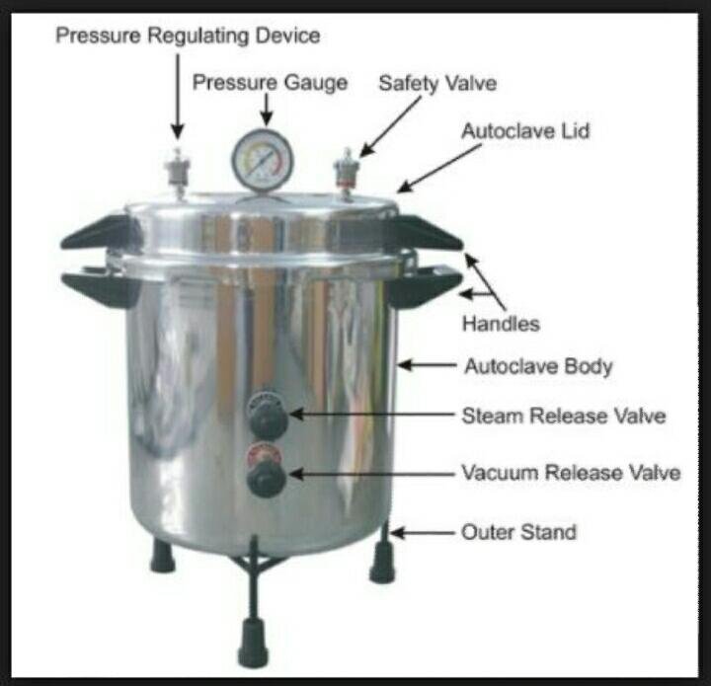
- These are also of 3 types :-
1. Gravity type
2. Pre-vaccume type
3. Retort type

Slide 29
1) Gravity type :-
Air is evacuated with the help of gravity alone.
Temp- 121 deg.C + Pressure 15 psi + Time 60-90 minutes.
2) Pre-vaccume type :-
Vaccume pump are used to evacuate air from the pre-vaccume
(i) Temp - 121°C, Pressure - 15 psi, Time -45 minute
(ii)Temp - 135°C, Pressure - 31 psi, Time -30 minutes
3) Retort type :-
It handle much larger volumes and
operate at much higher steam temp. and pressure.
Uses:-
Microbiology, biotechnology waste,
waste sharps, soiled and solid wastes

Slide 30
PLASMA PYROLYSIS :-
Commonly 3 state Solid, liquid & gas.
Plasma is the fourth state of matter made of electric conductivity or electro-magnetic field.
Every state changes due to HEAT.
From SOLID to LIQUID to GAS to PLASMA (Ions + Atoms + Electrone)

Slide 31
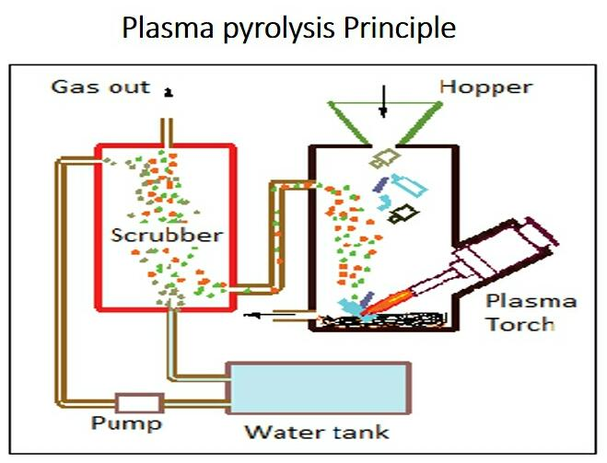
Plasma torch :-
Plasma torch :-
Instrument which generate plasma
Principle of Plasma Torch:-
1.Gas such as oxygen, nitrogen ,argon is forced
through small orifice inside the torch.
2.An electrical current from external power supply
is then introduced in that gas flow,
Which generate
-heat of temp. up to 40000 F.
-Electric conductivity
-Electromagnetic field
This all three are consider as “Plasma”
3.This Plasma come out from small orifice of the torch And through on object for decontamination ,wielding , cutting etc.

Slide 32
CHEMICAL TREATMENT :-
Sodium hypochlorite solution:-
Active against most bacteria, viruses & spores;
widely used for treatment of waste water.

Slide 33
MICROWAVE TREATMENT :-
-Moist heat and steam are generated by microwave energy and microwaving is essentially a steam based process.
Use For
Cultures
Sharps
Materials contaminated with blood / body fluids, (excluding chemical waste)
Soft waste - gauze, bandages, gowns and bedding

Slide 34
Items not to be put in microwave:
Chemical compound waste
Chemotherapeutic waste
Radiological waste

Slide 35
ISO 15189:2012
&
NABL 112
5.7 Post-examination processes
5.7.2 Storage, retention and disposal of clinical samples
The laboratory shall have a documented procedure for identification, collection, retention, indexing,access,storage, maintenance and safe disposal of clinical samples.
Safe disposal of samples shall be carried out in accordance with local regulations or recommendations for waste management.

Slide 36
NABL 112
• Autoclave should be calibrated every yearly.
• Check on effectiveness of sterilization with each cycle.
To maintain Documents and Records
Documents:
Procedure for storage and disposal of health care waste
2) Procedure for autoclave

Slide 37
Procedure for storage and
disposal of health care waste
Segregation
Write about Color category
Disinfection
Write about method of pre-treatment
Transport
Write about detail of transportation method

Slide 38
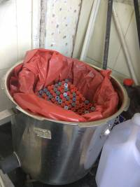
PROCEDURE FOR HOW TO AUTOCLAVE
•The interior of the autoclave is filled with water till a defined level.
• An empty bucket is kept in the autoclave.
•The red bag containing vacuttes , tips, ependroff cups, etc. is kept in the bucket.
Thereafter, autoclave is switched on after placing the lid.
It takes around 30mins to attain a pressure of
1-1.5 kg/cm².
When the pressure is obtained, the safety whistle
will be raised and a sound will be heard.
Switch off the autoclave
Lid of autoclave should not open atleast for 30mins.

Slide 39
Record of BMW as per ISO
Record training of latest rules of BMW
Record of Immunization of hospital & laboratory staff
Maintainance of Autoclave record.
Record of daily biomedical waste disposal record

