Slide 1
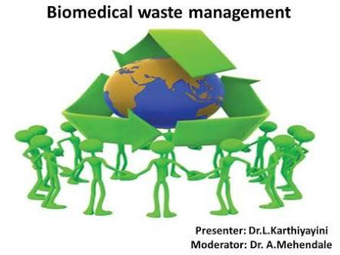
BIOMEDICAL WASTE MANAGEMENT
Golakiya nidhi
Baldaniya vishal
Ghodadra twinkal
Jokhakar dharmil
Loriya umesh

Slide 2
Bio-Medical Waste definition
Any waste which is generated during diagnosis , treatment or immunization of human beings or animal or in research activities.
In BMW, Hospital or Laboratory has to define policy for segregate and disposal of General waste.
The act was passed by the ministry of environment and forest in 1986 and notified the BMW rules in July 1998.

Slide 3
Source of biomedical waste
Clinics
hospitals
Medical laboratories
Blood banks
Mortuaries
Medical research & training centers
Animal houses etc.
Such a waste can also be generated at home if health care is being provided there to a patient (e.g. injection, dressing material etc.)

Slide 4
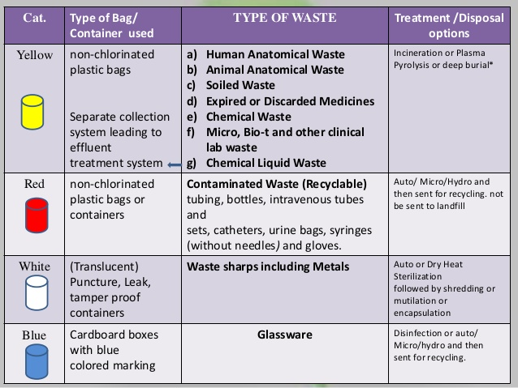

Slide 5
Chemical Reagent As Per MSDS
What is MSDS (Material Safety Data Sheet)?
MSDS Contain
  Composition
  Stability & Reaction
  Transport , Handling & Storage information
  Safety measures & Personal Protection
  Safe disposal
For e.g.
Creatinine test reagent (R1 – NaOH & R2 Picric acid):
Disposal of NaOH reagent
  Neutralize it with dilute acetic acid.

Slide 6
How to handle mercury spillage?
Wear rubber or latex gloves.
Broken glass piece
  Big glass with rubber brush & plastic supadi.
  Small glass pick with forceps.
Put in paper towel
Fold it & place in zip locking bag.(label it)
Use a rubber brush and Eye dropper to gather mercury beads.
Squeeze mercury onto damp paper.
Place it in a zip locking bag.(label it)
Gloves used during process also sent with bag.

Slide 7
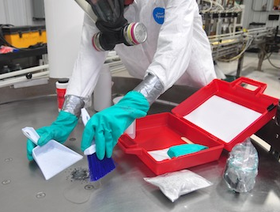

Slide 8
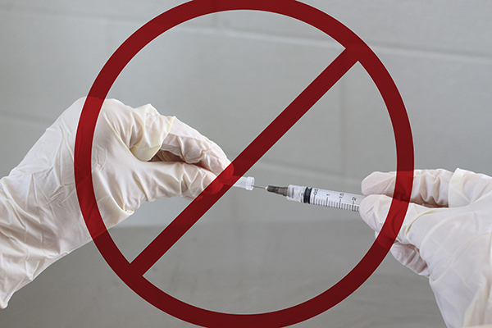
Handling of Needle and Syringe
Do not recap the needle to avoid needle prick injury.
Dispose needle into white puncture proof container.
Container should be filled with 1% Hypochloride solution.
It should be leak proof and tightly packed.
When container is ¾ filled with needle ,change it with new container.
It should be change at every 72 hours.

Slide 9
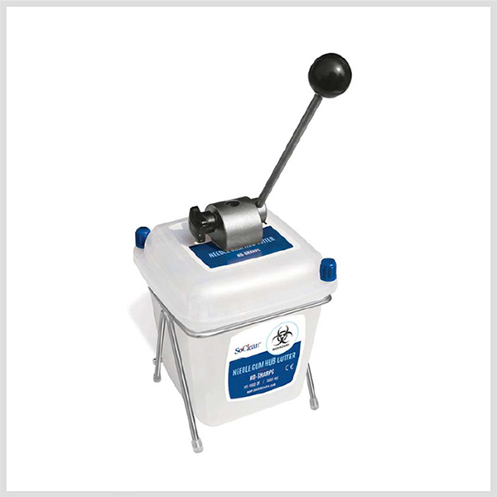
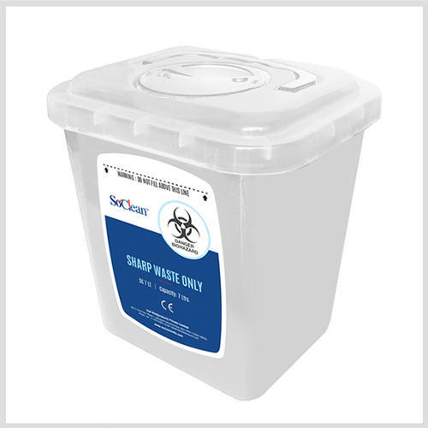

Slide 10
How to make 1% HOCl solution
N1V1 = N2V2
5% V1 =1% 1000 ml
V1 = 1% 1000
5%
= 200 ml

Slide 11
Prepare 0.5 mmol/L HCL from Conc.HCL
(Use Below Detail)
Specific Gr-1.018
Conc.-38%
Volume -100ml

Slide 12
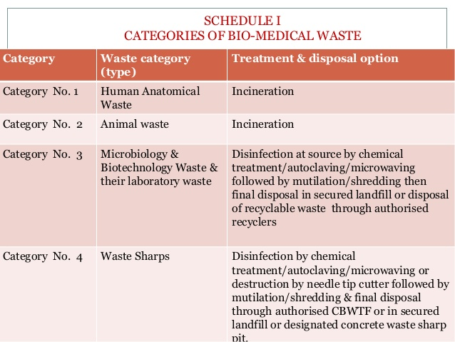

Slide 13
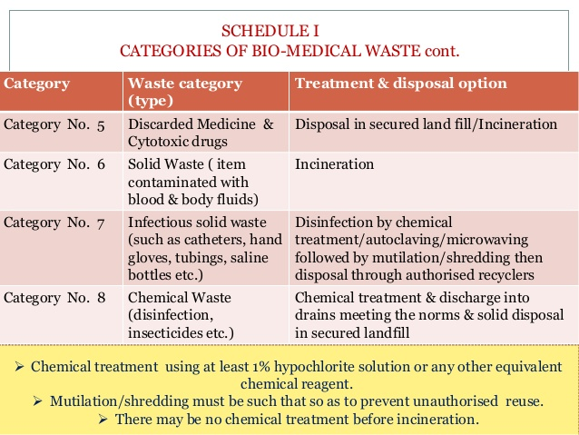
Soiled waste

Slide 14
Radioactive waste
Source
Drugs (cancerous drugs)
Dyes (Iodine & Barrium)
Diagnostic kits (RIA)
Excreta from patient treated with radionuclide substance.
This type of waste has a low level radioactivity.
PACKAGING
1.WHITE I-Almost no radiation
max. 0.5 mrem/hr on package surface.
2.Yellow II-low level radiation
max.50 mrem/hr on package surface.
3.Yellow III-high level radiation
max.200 mrem/hr on packag surface.

Slide 15
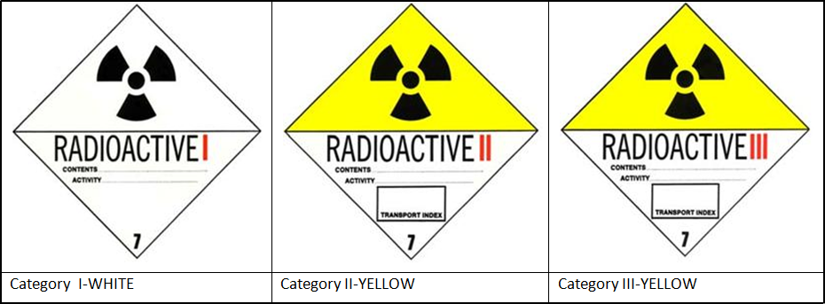
Disposal management
For disposal of radioactive waste in hospital yellow II type bag is used.
Low level radioactive waste can be sent for landfill.
Low level waste can be stored in depth sea until the radioactivity fallen to safe level.

Slide 16
Steps for waste management
1. Segregation
(As per BMW Guideline)
2. Collection and storage
(Leak Proof & At Separate Place (Not accessible to public) + With Bio-hazard Symbol
3. Transportation
(As per BMW Guideline)
4. Treatment and disposal (As per BMW Guideline)

Slide 17
TRANSPORTATION AND STORAGE
Temporary stored at the central storage area of the hospital
Than sent in bulk to the site of final disposal once or twice a day depending upon the quantity of waste.
Point to Care During transportation
  Every bag must have “ Bio Hazard Symbol”
  Kept at Separate area (not accessible to unauthorized public )
  Properly sealed and labeled.
  Bags should not be filled completely
  Bags can be picked up by the neck again
  Hand should not be put under the bag.
  At a time only one bag should be lifted.
  Manual handling of waste bags should be minimized
  BMW shall not be kept stored for more than 48 hours

Slide 18
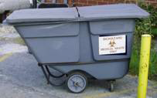

Slide 19

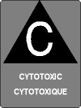
TRANSPORT TO FINAL DISPOSAL SITE
From health care establishment to the site of final disposal
In a closed motor vehicle (truck, tractor‐trolley etc.)
prevents spillage of waste on the way.
Vehicles used for transport of BMW must have the “Bio‐Hazard” symbol
These vehicles should not be used for any other purpose.
Note: Label shall be non‐washable & prominently visible.

Slide 21
Label for Transporting BMW bags
Date of Transport
Date of Waste generation
Waste category no
Waste quantity
Sender’s Name & Address
Phone of Contact Person
In case of Emergency contact number of Sender:
Receiver’s Name & Address
Phone number of Receiver

Slide 22
Final treatment( on site)
Deep burial:
  Category 1 and 2 only
  In cities having less than 5 lakh population & rural area.
  In the deep burial ,pit depth is 2 meter.
  Burial site secured with covers of wire mash.
  After every burial in the same secured pit a layer of 10 cm. soil should be added.
  There should be no well , river , lake close to the site.(300meter )

Slide 23
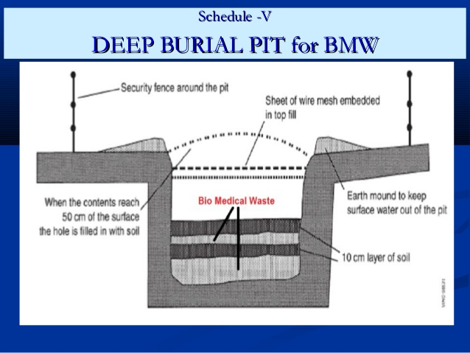

Slide 24
•Shredding:
Only after chemical treatment/autoclaving.
The plastic (I.V. bottles, I.V. sets, syringes, catheters etc.), sharps (needles, blades, glass etc)
Needle destroyers can be used for disposal of needles directly without chemical treatment.
•Land disposal:
Pre - treatment is optional.
Secured/Sanitary landfill
Incinerator ash, discarded medicines, cytotoxic substances and solid chemical waste .

Slide 25
Sanitary landfill Process
Digging a large pit in ground.
There must be at least 3 m gap between ground water and landfill.
Site should be 250 meter away from river ,stream.
Lined it with plastic layer (2-4 feet) or clay.
For the collection of leachates plumbing of pipe at the bottom.

Slide 26
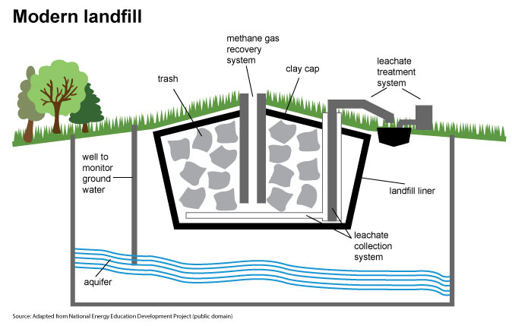

Slide 27
Incineration
Category 1, 2, 3, 5, and 6 can be incinerated.
high temperature(110-850 C) dry oxidation process.
Convert organic combustible waste to inorganic incombustible
Generate Ash ,flue gas and heat.
Used for the waste that can not be reused, recycled or disposed in landfill site.
For this process certificate require from CPCB/State Pollution Control Board

Slide 28
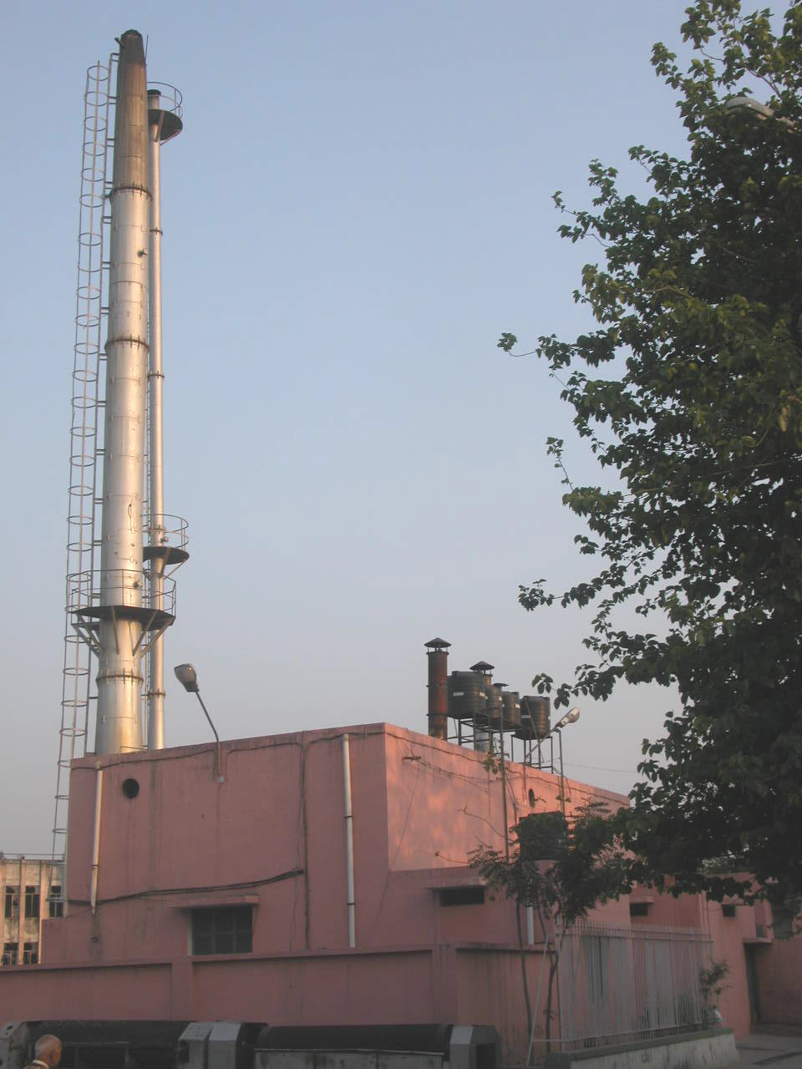
Incinerator
Notes:
Incinerator

Slide 29
Plasma Pyrolysis
What is plasma ?
Commonly 3 state liquid, solid & gas.
Plasma is the fourth state of matter made of electric conductivity or electro-magnetic field.
Every state changes due to HEAT
  From SOLID to LIQUID to GAS to PLASMA (Ions + Atoms + Electrone)

Slide 30
Plasma Torch
Plasma torch
  Instrument which generate plasma
Principle of Plasma Torch
  Gas such as oxygen, nitrogen ,argon is forced through small orifice inside the torch.
  An electrical current from external power supply is then introduced in that gas flow,
  Which generate
    heat of temp. up to 40000 F.
    Electric conductivity
    Electromagnetic field
  This all three are consider as “Plasma”
  This Plasma come out from small orifice of the torch
  And through on object for wielding , decontamination , cutting etc.

Slide 31
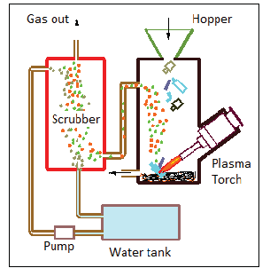
Plasma pyrolysis Principle

Slide 32
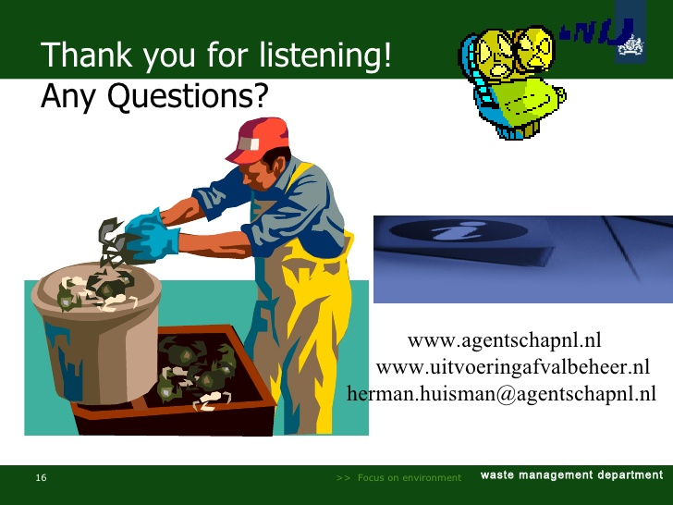
THANK YOU

