Slide 1
Government Medical College ,Surat
Group:-3
Batch No:- 95
Guidance by:- Dr.S.M.Patel

Slide 2
Group Members :
Roll Num.
Chhatrala Janki 21
2) Chauhan Bhargav 22
3) Dalal Shivani 23
4) Darji Deepak 24

Slide 3
Case:- Snake Bite

Slide 4
History
We visited patient at H-3 ward of the new civil hospital.
The patient is male of 25 years old bitten by snake late evening
At 26 September 2016.
Admitted in the EMERGENCY WARD.
Snake Specification :- Snake was 30 cm long with spots

Slide 5
Snake bite was on the medial side of left ankle
And this area had edema
The patient is currently on following medication-
Anti Snake Venom
Neostigmine
REPORT at night of 26th September 2016
Prothrombin Time – 28s
WBCs count – 15800

Slide 6
Biochemistry REPORT at 27/9/2016 2:45 A.M.
TEST | RESULT | REFERENCE RANGE | ALERT
Albumin | 3.7 | 3.5-5.2g/dl
Alk.Phosphatase | 117 | 42-128U/L
ALT | 37 | <45U/L
Direct Bilirubin | 0.3 | <0.4mg/dl
Total Bilirubin | 2.5 | <1.3mg/dl | High Abnormal
Indirect Bilirubin | 2.2 | <1.3mg/dl | High Abnormal
Creatinine | 0.8 | 0.8-1.3
k+ | 3.39 | 3.5-5.1mmol/L | Low Abnormal
Na+ | 135.47 | 136-145mmol/L | Low Abnormal
Total Protein | 6.1 | 6.4-8.3g/dl | Low Abnormal

Slide 7
27/9/2016 Pathology REPORT at 5 P.M.
Prothrombin Time – 13s (Normal)

Slide 8
Biochemistry REPORT at 28/9/2016 2:40 A.M.
TEST | RESULT | REFERENCE RANGE | ALERT
Albumin | 3 | 3.5-5.2g/dl | Low Abnormal
Alk.Phosphatase | 81 | 42-128U/L
ALT | 194 | <45U/L | High Abnormal
Direct Bilirubin | 2.1 | <0.4mg/dl | High Abnormal
Total Bilirubin | 3.7 | <1.3mg/dl | High Abnormal
Indirect Bilirubin | 1.6 | <1.3mg/dl | High Abnormal
Creatinine | 1.2 | 0.8-1.3
k+ | 3.27 | 3.5-5.1mmol/L | Low Abnormal
Na+ | 137.09 | 136-145mmol/L
Total Protein | 5.3 | 6.4-8.3g/dl

Slide 9
Pathology REPORT at 28/9/2016 3.00 A.M.
Prothrombin Time – 25s (Abnormal)
WBCs count – 16900
No Previous history of surgery and hospitalizations
Occasional drinker of alcohol.

Slide 10
ALT ( Alanine Transferase enzyme )
ALT is an Alanine transferase enzyme. It is a marker
of hepatocellular damage which means
damage to liver which happens in hepatitis.
It may be of viral origin, congestive heart failure,
diabetes, bile duct problem etc.
An increase in ALT suggests disease is in active or
progressive phase.

Slide 11
Bilirubin
Conjugated bilirubin :
Bilirubin bound to glucuronic acid is called
conjugated bilirubin which has 6 hydroxyl
group.
This Conjugation occurs in liver and excreted in bile

Slide 12
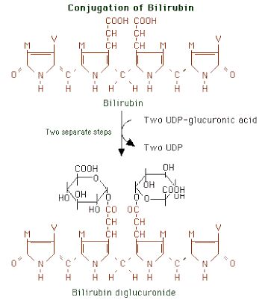
Conjugated Bilirubin

Slide 13
This figure shows conjugated bilirubin.
Lower part of figure shows two rings with many COOH group
attached to main bilirubin molecule.
They are glucuronic acid. They are water soluble, making entire
conjugated bilirubin water soluble

Slide 14
Unconjugated bilirubin :
Unconjugated bilirubin is not bound to glucuronic acid since it has only 2 hydroxyl groups it is not water soluble
So it binds with plasma protein albumin.
This way it circulates in blood with the support in albumin

Slide 15
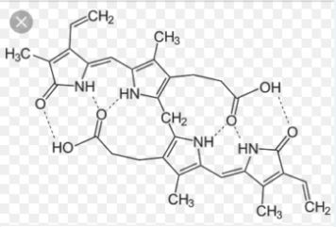
Unconjugated Bilirubin

Slide 16
Unconjugated bilirubin can form six hydrogen bonds, they are
intramolecular.
So it can not form H bond with water. So it is very less soluble
in water.
Once it is conjugated, there are many H bonds possible
with bilirubin and glucuronide attached,
making conjugated bilirubin very water soluble.

Slide 17
In Lab, bilirubin is measured by it’s ability to form red colored compound with certain chemical.
The compound which produces red color with bilirubin is called diazotised sulphanilic acid .
Conjugated bilirubin directly reacts water so it is called direct bilirubin .
Unconjugated bilirubin does not reacts with water. Hence this is called
Indirect bilirubin .
We can seprat it from albumin by adding methanol.

Slide 18
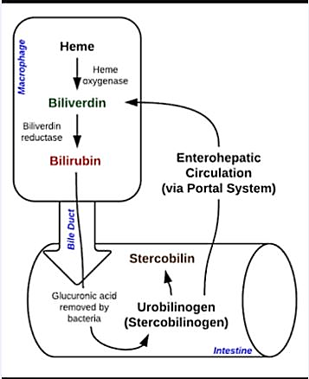

Slide 19
Differential Diagnosis
Condition 1:- Destruction of large number of RBC, as in malaria, haemotoxic
snake venom, sickle cell anaemia, extravascular haemolysis etc.
Observation:- Increased level of indirect bilirubin
Reason:- When lot of bilirubin is formed by macrophages, liver capacity for conguation is full. So unconjugated bilirubin accumulate.
There is good capacity of liver to throw conjugated bilirubin in bile.
So conjugated bilirubin does not increase when RBC killed.

Slide 20
Condition 2:- Destruction of hepatocytes as in viral hepatitis, alcoholism etc
Observation:- Increased level of indirect (unconjugated) and direct (conjugated) bilirubin.
Reason:- Hepatocytes convert unconjugated bilirubin into conjugated but due to
their destruction unconjugated bilirubin level increase.
Also due to inflammation of liver, on destruction of hepatocytes,
bile canals are blocked hence conjugated bilirubin level also rises

Slide 21
Condition 3:-Bile canaliculi is blocked as in obstructive jaundice.
Bile canaliculi are small canal which get pressed
and blocked by liver inflammtion
Observation:- Increased level of direct bilirubin in liver
Reason:- Due to accumulation of bile in liver along with it the conjugated bilirubin
formed inside the liver is also accumulated.
Prothrombin time is about a blood report that measures the time required to
clot blood. Normal value is about 12- 14 second.

Slide 22
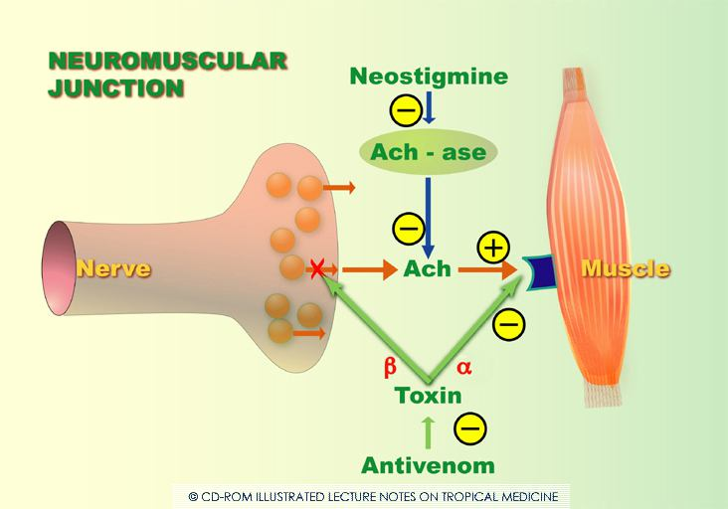

Slide 23
1. Why some snake bite cause muscle paralysis ?
Answer: Refer to figure above to understand following
alpha refers to alpha-toxin (alpha bungarotoxin), which is a protein.
Beta refers to beta-toxin (beta bungarotoxin). It is also a protein.
Ach(Acetylcholine) is released from Nerve and Bind receptor protein on Muscle -> Causing muscle contraction
alpha bind receptor protein on Muscle and prevent Ach from binding muscle -> Muscle do not contract -> Paralysis.
Beta-toxin is a phospholipase A2, probaby damaging nerve cell membrane. This results in decreased release of ACh from Nerve. -> Muscles do not contract -> Paralysis

Slide 24
Acetylcholinesterase is the enzyme which catalyses ACh to acetic acid n choline molecule. It is found in neuromuscular junction and cholinergic synapse.
Inhibition of AChE leads to accumulation of ACh in the synaptic cleft and causes transmission of nerve signal which causes increased muscle contraction

Slide 25
Snake Venom
Snake venoms are used in the production of snake antivenom as hyperimmunizing antigens. Snake venoms are complex substances that, depending on the species, can contain a variety of toxins.
Toxin components can include proteases, nucleases, phosphodiesterases, and Other
enzymes which disrupt physiological processes and cellular integrity.
The venom toxins are largely classified as neurotoxins, cytotoxins, myotoxins, and cardiotoxins.
Venomous snake bites may cause a variety of symptoms, including pain, swelling, tissue necrosis, hypotension, neuromuscular collapse, blood clotting dysfunction,
respiratory paralysis, kidney failure, coma and death.

Slide 26
Manufacturing and Production of Antivenom
Antivenoms are typically produced using a donor animal, such as a horse or sheep.
The donor animal is hyperimmunized with non- lethal doses Of one or more venoms to
produce a neutralizing antibody response.
Then, at certain intervals, the blood from the donor animal is collected and neutralizing
antibodies are purified from the blood to produce an antivenom.

Slide 27
PLA2 is enzyme naturally occuring in our body cells. But when it is present in excess in ECF due to snake bite , it destroy cell membrane containing phospholipid.
The result is:
Cell death —> Inflammation (high WBC) —-> Oedema
RBC lysis —> Hemolysis —> increased indirect bilirubin
Hepatocyte lysis —> hepatitis —> increased indirect + direct bilirubin
Pro coagulant- serine proteinase or metalloproteinase and Anti coagulant type - PLA2
They cause variation in prothrombin time

Slide 28
What Is Alkaline Phosphatase?
Alkaline phosphatase is an enzyme found in your bloodstream.
ALP helps break down proteins in the body and exists in different forms, depending on
where it originates.
It is mostly produced in your liver, but some is also made in your bones, intestines, and
kidneys. In pregnant women, ALP is made in the placenta

Slide 29
Liver and Gall Bladder
Checking ALP levels in the blood is a routine part of a liver function and gall bladder tests.
Symptoms such as jaundice (yellowing of the skin and eyes), abdominal pain, vomiting, and
nausea may lead your doctor to suspect there is something wrong with your liver or gallbladder
The ALP test can be helpful in identifying conditions such as:
• hepatitis (inflammation or infection of the liver)
• cirrhosis (scarring Of the liver)
• cholescystitis (inflammation of the gallbladder)
• blockage of bile ducts (from gallstone, inflammation, or cancer)
You may also need an ALP test if you are taking a medication that has the potential to
damage your liver, such as acetaminophen (Tylenol). Measuring ALP is one way to check
for that damage.

Slide 30
Identification of snakes

Slide 31
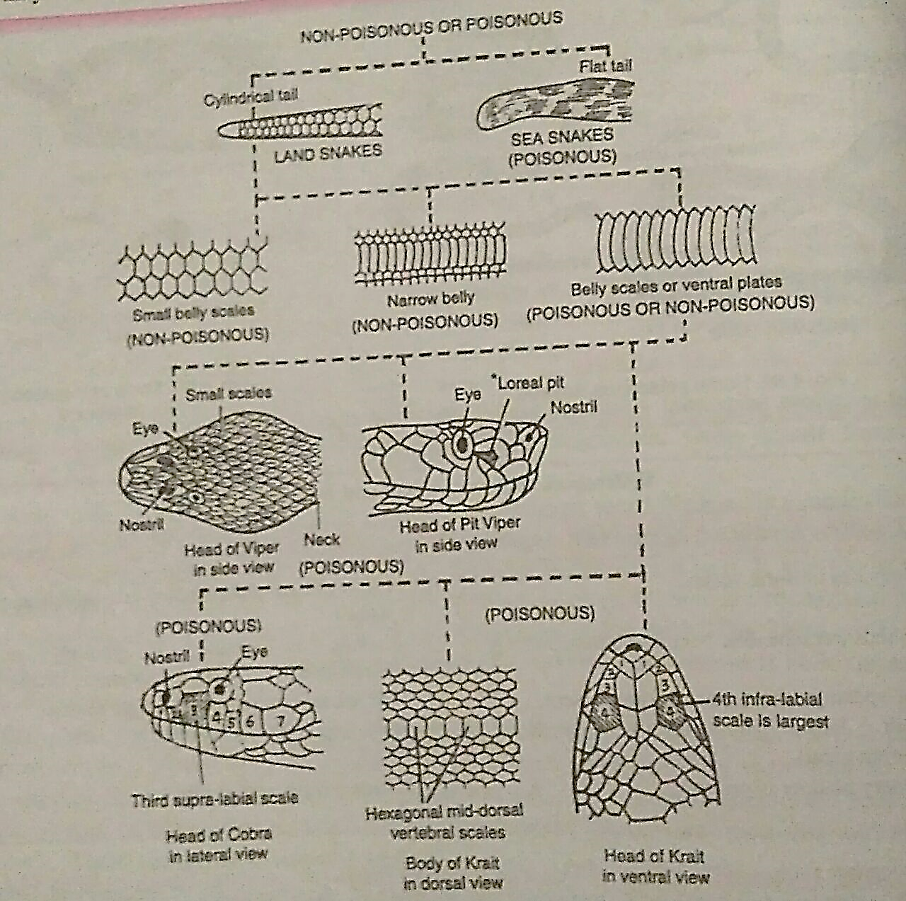

Slide 32
Structures | Characters | Nature | Snakes
1.Tail | A)Tail laterally compressed,oar-like (b) Tail cylindrical, tapering | Poisonous, Hydrophis, Enhydrina Poisonous or non-poisonous, Examine further | Sea snakes Land snakes
2. Belly scales or ventrals | (a) Belly scales small, continuous with dorsals (b) Ventrals not fully broad to cover belly (c) Ventrals broad. filly covering belly | Non-poisonous Non-poisonous Examine further | Pythons

Slide 33
Structures | Characters | Nature | Snakes
3. Head scales sub-caudals | (a) Head scales small, head triangular. No loreal pit (i) Loreal pit, (ii)Subcaudals single (b) Head scales shield like. A loreal pit present between nostril and eye (c) Head with Iarge shields. No loreal pit | Poisonous Poisonous Poisonous Poisonous Examine further | Pitless vipers Vipera russelli Ancistrodon Echis carinata Pit vipers

Slide 34
Structures | Characters | Nature | Snakes
4. Vertebra's, 4th infralabial 3rd supralabial | (a) Vertebrals enlarged, hexagonal 4th infra-labial largest (bVertebrals not enlarged, 3rd supra- labial touches eye and nostril (i) Neck with a hood and spectacle mark (ii) Hood absent. Coral spots on (c) No such characters | Poisonous Poisonous Poisonous Poisonous Non-poisonous | Krait, Bungarus Cobra, Naja Coral snakes

Slide 35
Thank You

